Slide 1

Leader as Coach
Presented by
Randall Preiser
Notes:
The Institute for Social & Emotional Intelligence (ISEI) is an international learning and research organization supporting life coaches, executive coaches and HR professionals as they bring social and emotional intelligence into the workplace and life beyond work. The Institute for Social & Emotional Intelligence provides certification in the use of the Social & Emotional Intelligence Profile (SEIP), the most comprehensive, fully-validated and statistically reliable social and emotional intelligence assessment instrument on the market today. Based on the latest research models of social and emotional intelligence, and the ones in use by over 75 percent of Fortune 500 Companies, the SEIP is being used by coaches around the globe.

Slide 2
Welcome
Please, no cell phones
We will be starting and stopping on time
Active participation is requested of everyone
Confidentiality is essential – what is said in this room stays in this room
Let’s all benefit from your contributions (No side conversations)
Listen actively; seek to understand
Be mindful of your “floor time”
Other ground rules ???
Breaks and lunch logistics

Slide 3
Agenda
Day 1
  What is coaching and a “coach approach to leadership”?
  Why bother?
  Coaching style vs. the “old style”
  A model of coaching
  Foundational coaching skills
  The coaching conversation
  PRACTICE, PRACTICE, PRACTICE

Slide 4
Day 2
  Your communication and coaching style
  Skills for developing others
  Observation & feedback
  Action planning
  PRACTICE, PRACTICE, PRACTICE

Slide 5
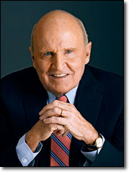
Jack Welch
“Being a leader changes everything. Before you are a leader, success is all about you. It’s about your performance, your contributions. It’s about getting called upon and having the right answers. When you become a leader, success is all about growing others. Your success as a leader comes not from what you do but from the reflected glory of the people you lead.”
Notes:
Now THAT is a big transition !!! Being a leader is a whole new mindset !!! It means shifting our mindset from supervisor to coach.

Slide 6
Learning Objectives
Shift from supervisor to “Leader as Coach”
Become proficient and comfortable using coaching skills to help others learn, develop and grow in the workplace
Integrate and apply the techniques of the coaching conversation and the coaching process seamlessly into everyday interactions
Identify and describe your communication and coaching style and the communication styles of others to ensure coaching success
Support and challenge your best performers to greater levels of achievement
Create and implement your own development action plan to hone your coaching skills
Develop a coaching culture in your part of the organization

Slide 7
Definition of Coaching
Coaching is a developmental process designed to help individuals and teams achieve and sustain top performance in support of the organization’s goals.

Slide 8
What is coaching?
An essential skill for leaders and managers
An ongoing partnership, a sustained alliance
A process for promoting discovery, learning, growth and higher levels of performance
A collaborative effort where the coach serves as a strategic thinking partner, and manager and employee think and plan together

Slide 9

The Telling – Asking Continuum
Pros & Cons?

Slide 10
What coaching is not
Telling people what to do
Fixing problem performers
Therapy, consulting or training
A time-consuming process
Someone else’s job
A one-time event
Just another management fad

Slide 11
Leadership Styles are Changing
The “old style” is no longer working
Gallup Research
  In large companies (> 5000 employees), only 19 percent of employees feel engaged
  22 percent in mid-sized companies
  33 percent in small companies (< 50 people)
        First Break All the Rules, 1999

Slide 12

The “ROAD WARRIOR” Phenomenon
Retired
On
Active
Duty . . .

Slide 13
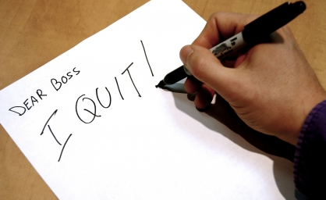
People join organizations . . .
. . . but leave managers
  The # 1 reason people leave their jobs is because of their direct manager

Slide 14
Same study: “Talented” Managers
The opposite of disengaged employees is satisfied, engaged employees
“Talented” managers – those who take a coach approach to managing and leading – tend to have more satisfied employees
Organizations with above-average employee satisfaction scores also had:
  38 percent higher customer satisfaction scores
  22 percent higher productivity
  27 percent higher profits

Slide 15
What do people want in a manager?
To know what is expected of them at work
The opportunity to do their best every day
To make a contribution
To be recognized for their work
To have someone at work care enough to encourage their development
To have their opinions count and be heard
To have the opportunity to learn and grow
To be respected
        See p. 8 for the “Gallup 12”

Slide 16
Dr. Gerald Graham
(Wichita State University)
Surveyed 1,500 people from a wide variety of organizations and professions.
58 percent of the respondents seldom if ever received personal thanks from their manager.
76 percent seldom if ever received written thanks from their manager.
A verbal or written thank you from one’s manager are the two top incentives according to employees.

Slide 17

Benefits of Coaching
Makes the manager’s job easier
Reduces turnover and associated costs
Increases productivity; improves work quality
Promotes innovation (safe place to take risks)
Clarifies manager’s expectations
“Stretches” people to reach for bigger goals
Other?

Slide 18
Six Leadership Approaches
Authoritative (Visionary)
Democratic
Affiliative
Coaching
Coercive
Pace-setting
      From Daniel Goleman’s Leadership That Gets Results article in Harvard Business Review, March-April, 2000

Slide 19
“Old Style” vs. “Leader as Coach”
“Old Style”
“Leader as Coach”
  Directs, dictates, talks a lot
  Presumes, assumes
  Manages only for results
  Solves problems in isolation
  Assigns blame
  Guides, empowers, listens a lot
  Explores, discovers
  Manages the development of employees
  Creates partnerships with employees to collaboratively solve problems
  Takes responsibility
  Exercise on p. 11

Slide 20
Coaching Skills
Foundational Skills: The Practice of Dialogue
Advanced Coaching Skills: Developing Others
The Critical Skill: Honest Feedback

Slide 21
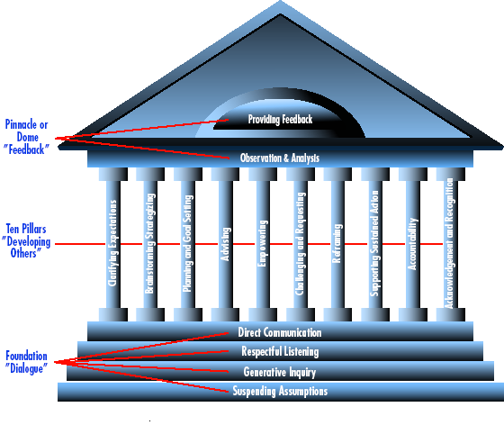
A Model of Coaching

Slide 22
The Practice of Dialogue
Shared inquiry, a way of thinking together
Four primary skills:
  Suspending assumptions
  Generative inquiry -- “Smart Questions”
  Respectful listening -- “Deep Listening”
  Direct communication -- “Straight Talk”
At its core, an attitude of respect

Slide 23
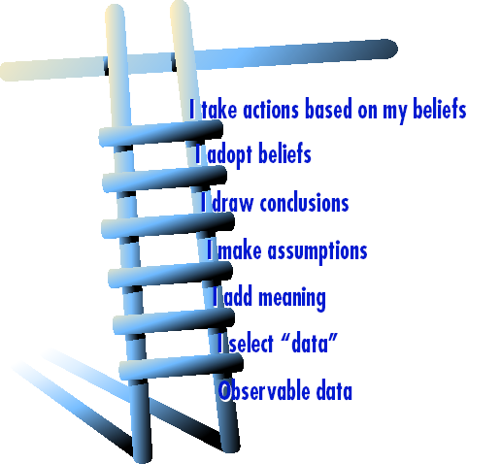
Suspending Assumptions:
The Ladder of Inference (p. 27)

Slide 24
“The true test of a first-rate mind is the ability to hold two contradictory ideas at the same time.”
- F. Scott Fitzgerald, author

Slide 25
Suspending Assumptions: How to do it
Be aware of your assumptions, and new ones in the moment they arise
Give voice to your assumptions; ask for clarification and input
Be open to new ideas
Be willing to be influenced by the conversation
Make it safe for people to say what they think
Suspend your certainty
Hold your judgments and criticisms – be aware of the thoughts and feelings as they come up, and hold them for later use
Avoid stating your opinions & positions from the outset; ask questions to generate mutual exploration

Slide 26
Smart Questions
Powerful – focus is on generating new thinking, expanding possibilities
Make questions:
  Open-ended
  Brief (no speeches leading up to the question)
  Neutral
  Constructive
  Evoke forward movement

Slide 27
Neutral Questions . . .
. . . do not create bias
“Given the number of errors detected on the widget manufacturing line, don’t you think we should create a quality control department?”
“Given the current budget situation, do you really think we should spend money to establish a quality control department?”
“What should we do about quality control?

Slide 28
Neutral Questions Exercise
Page 16 in your Participant Manual
Convert the questions to neutral language

Slide 29

Constructive Questions
“How can we eliminate racial bias in this department?”
“How can our department become the model of diversity for this entire organization?”

Slide 30
Smart Questions: How to do it
Break the habit of only making statements (strive to make at least half your utterances questions)
Carefully formulate questions that invite exploration and generate discovery
Frame them in a way that evokes an image of a positive or better future
Develop a list of good questions
Practice, practice, practice

Slide 31
Examples:
What do you want to have happen?
What’s the ideal?
What options have you considered?
Are there other possibilities here we haven’t considered yet?
If we took a completely fresh approach, what would that be?

Slide 32
Exercise One: Suspending Assumptions & Generative Inquiry
In table groups
Select one person to:
  think of a challenging work situation you have encountered in the last week;
  explain the situation non-stop for two full minutes;
  stop
Everyone else:
  listen only, no note taking, no questions during the 2 minutes
  develop 3-4 thought-provoking questions designed to invite exploration and generate discovery;
  write these on a piece of paper
Review questions with each other
Switch roles

Slide 33
Dialogue Skills
Suspending assumptions
Generative inquiry – “smart questions”
Respectful listening
Direct communication

Slide 34
Respectful Listening
Listening is an intentional and active exploration for meaning
Listening for context by hearing the words and knowing enough about a person’s external and internal circumstances to discern what is really being said at a deeper level
Listening reflectively by using appropriate attending, following and reflecting skills
Listening for:
  Verbal messages
  Nonverbal messages
  Context
  “Sour notes” -- gaps, distortion, dissonance

Slide 35
Self Test for Listening
Page 19
Are you a good listener?

Slide 36
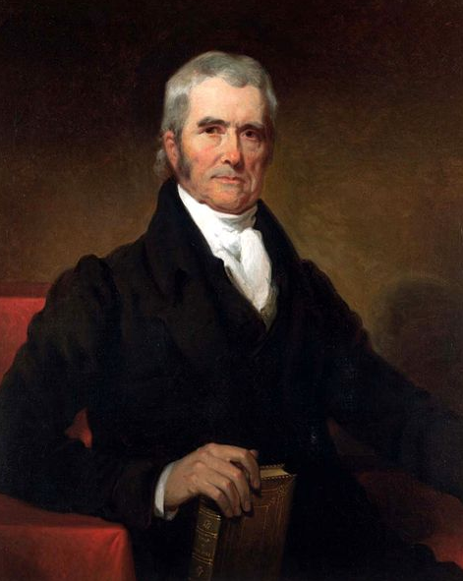
The Honorable John Marshall, Chief Justice of the Supreme Court, 1803 – 35
  “Listening well is as powerful a means of communication and influence as to speak well.”

Slide 37

Listening for Context
Listening for what’s not being said
Refer to the Contextual Listening Checklist (page 21)
Listening for the person’s
  Needs
  Motivations
  Values
  Goals and aspirations
  Energy level
  Strengths and where development is needed
  Barriers in his way and needed support

Slide 38
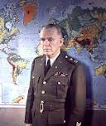
Formula for handling people . . .
Listen to the other person’s story.
Listen to the other person’s full story
Listen to the other person’s full story first.
According to General George C. Marshall, war hero, Secretary of State, developer of the Marshall Plan, Nobel Peace Prize Laureate

Slide 39
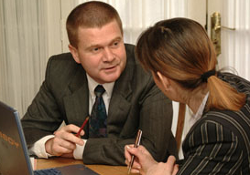
Reflective Listening Skills
Attending
Using a posture of involvement
Establishing and maintaining eye contact
Reinforcing what is being said through appropriate facial features and body movement
Assuring a non-distracting environment that demonstrates the you are psychologically present to the speaker

Slide 40

Active, Receptive & Reflective Listening Skills, cont.
Following
  Tuning in to how the other person is thinking and viewing a situation
  Door-openers
  Encouragers
  Open-ended questions
  Attentive silence

Slide 41

Active & Reflective Listening, cont.
Actively Reflecting
Comprehending, validating, accepting,
acknowledging (not judging)
Expressing understanding; empathizing
(not necessarily agreeing); viewing
things from the other’s perspective
Matching & mirroring
Acknowledging the mood of the other
person, their emotional state
Absorbing and re-stating the speaker’s
content and/or feeling
  Interpreting & summarizing
  (more than simply paraphrasing)
  Reflecting meaning / feeling
  Clarifying what the other has said

Slide 42
How to do it:
Set aside your own agenda; let go of the inner clamoring
Actively intend to listen and understand another’s ideas, position, feelings or attitude
Listen for what is said and not said
Listen for context
Engage in reflective listening
Acknowledge feelings
Say what you heard to verify
Ask for clarification; verify what was said and meant
Allow silence
“You cannot truly listen to someone and do anything else at the same time.”
- M. Scott Peck

Slide 43
Phrasing examples:
Help me understand what you mean by . . .
Tell me if I’m hearing you right . . .
Hmmm. Sounds like you’re feeling . . .
It sounds like you’re really passionate about this.
When you said . . . I assumed you meant . . .
Is that right?

Slide 44
Exercise Two: Respectful Listening
Find a partner (we’re working in pairs on this one)
Think of a situation you have encountered in the last week or two
Use the skills of respectful listening and smart questions to coach each other
Take turns being Coach. As Coach:
    Spend 5 minutes listening and asking questions
    Refer to your contextual listening checklist as needed
    As you listen, write down clues as to what you’re hearing
    Use your reflective listening skills (attending, following, reflecting)
    Ask questions to clarify
    Verify what you hear

Slide 45
Direct Communication / Straight Talk
Telling the truth; being candid
Reveals your inner thoughts & perceptions
Identifying mismatches between what is said and what is known
Challenges distortions; identifies gaps
No put-downs or “make-wrongs”

Slide 46
“Courageous speech has always held us in awe.”
- David Whyte, The Heart Aroused

Slide 47
Exercise 3: Straight Talk Scenario
One of your peers, a Vice President from another department, comes to you with a problem. She recently received a promotion, and is relatively new to this level of leadership.
She tells you about an individual on her team who is not performing. She was a member of this team before her promotion, and she was acutely aware of the problem before becoming VP. Everyone else on the team is aware of the problem as well, and it is significantly hurting morale.
Her team is expecting her to take action to resolve the issue with the problem employee. After all, she was the one to receive the promotion. She is their last hope. A lack of action on her part will further the downward spiral in morale, possibly result in the loss of valuable talent, and seriously damage her credibility as a leader.
How will you coach her? In addition to deep, respectful listening and smart questions, demonstrate your skills of “Straight Talk.”

Slide 48
Direct Communication Model
The following structure for coaching will allow you to have short conversations that make a big difference. Hundreds of leaders have used this structure with great success. So can you.
The format consists of four main elements:
  Opening Statement
  Observation
  Impact
  Request

Slide 49
1. Opening Statement
‘‘I want to talk to you about (the category of performance).’’
2. Observation
‘‘I’ve observed (describe the performance or behavior).’’

Slide 50
3. Impact
‘‘The impact is (describe the impact on the people or the job being done).’’
4. Request
‘‘From now on, I’d like you to (describe how to improve performance/behavior).’’

Slide 51
Straight Talk - How to do it:
Solid foundation of trust is a prerequisite
Listen for mismatches, gaps, distortions, biases, or lack of ownership of the problem
Tune into your own reactions and thoughts about what you’ve heard expressed and ask, “what needs to be expressed now?”
Frame your truth diplomatically
Speak quietly, non-judgmentally and non-emotionally
Use specific examples
Make your thinking process visible
Trust yourself to say the right thing if it comes from the intention of wanting to help the other person grow

Slide 52
Phrasing examples:
Your opening statement will identify the general topic of the coaching, for example:
  ‘‘I want to talk to you about (category of performance).’’
  The project you completed this morning
  The goals and objectives status report for your department
  The plan you submitted for our reorganization

Slide 53
Phrasing examples:
‘‘I’ve observed (describe the performance or behavior).
  ‘‘Your status report failed to include your targets for last Friday. . . .’’
  “that you volunteered to help out on Jim’s project this morning . . .’’

Slide 54
Phrasing examples:
‘‘The impact is (describe the impact on the job being done).’’
  You describe a specific aspect of performance or behavior. Now you want to make clear why you are bringing this to their attention: What they did or how they behaved had a positive or negative impact on the other people in the organization or on the job in some way— customer service, costs, morale, the company’s image, quality, efficiency, to name just a few.

Slide 55
Phrasing examples:
‘‘From now on, I’d like you to (describe how to improve performance/behavior).’’
  What you have accomplished up to this point is a description of a behavior or performance and its impact on the job being done. Corrective coaching must also include suggestions on how to improve the performance or behavior. You have to be clear in your description of the desired level of performance and why.

Slide 56
Other Phrasing Examples:
May I offer my thoughts and trust you will receive them as intended: as a way to help you overcome this hurdle?
Sue, I hear you say the morale of your team is your highest priority, but do you realize that by refusing to deal with a non-performer, you are hurting morale?
John, what part of this problem is yours?
I’m having difficulty seeing it the way you’re seeing it . . . Here’s what I’m seeing . . .

Slide 57
Round-Robin Coaching
In groups of three
One person is the coach, one is the person being coached, and one person is the observer
Coach for 10 minutes
Time will be called
Debrief for 3 minutes – observer provides feedback on the coaching skills observed, and the person being coached provides feedback as well.
Switch roles – new coach, new observer, new “coachee”

Slide 58

Coaching Practice

Slide 59
Exercise 3: Straight Talk Scenario
One of your peers, a Vice President from another department, comes to you with a problem. She recently received a promotion, and is relatively new to this level of leadership.
She tells you about an individual on her team who is not performing. She was a member of this team before her promotion, and she was acutely aware of the problem before becoming team lead. Everyone else on the team is aware of the problem as well, and it is significantly hurting morale.
Her team is expecting her to take action to resolve the issue with the problem employee. After all, she was the one to receive the promotion. She is their last hope. A lack of action on her part will further the downward spiral in morale, possibly result in the loss of valuable talent, and seriously damage her credibility as a leader.
How will you coach her? In addition to deep, respectful listening and smart questions, demonstrate your skills of “Straight Talk.”

Slide 60
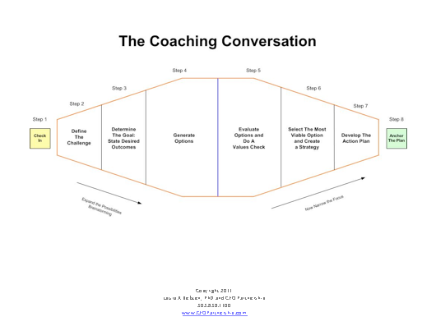
The Coaching Conversation

Slide 61
1. Check-in
Focus the conversation
Establish the purpose of having a conversation
What is the issue (or issues) to be addressed?

Slide 62
2. Define the Challenge
Establish a common understanding of the problem or challenge
Identify the stakeholders being impacted
Assess the budgetary implications of the challenge (if necessary)
State the problem in a single clear statement

Slide 63
3. Determine the Goal
What is the ideal or desired outcome?
If this issue is resolved, what will success look like?
What is the result if this problem is resolved?
Craft a goal statement (this is not a solution statement, but a goal statement)

Slide 64
4. Generate Options
Ask questions to stimulate thinking
Encourage innovative thinking
Quiet your mind & listen non-judgmentally
Refrain from offering your own solutions (at least initially)
Brainstorm to explore options
Paraphrase what you are hearing
Draw out consequences
Share personal experiences and your ideas after the person you are coaching has offered his/hers

Slide 65
5. Evaluate Options
Begin to narrow the focus
Eliminate unworkable options
Do a values check – are the options you are considering aligned with the organization’s mission, vision and values? Are they fair? The right thing to do? Eliminate those options which don’t pass the values check.
Of the remaining options, identify the one or two which will get you most directly to your goal, to problem resolution

Slide 66
6. Select the Most Viable Option
Brainstorm various strategies to get you to your goal
Explore resource needs of the various strategies
Identify potential barriers of each strategy and what action is needed to clear barriers
Select the most viable option and begin to guide the person you are coaching to the development of an action plan

Slide 67
7. Develop the Action Plan
Guide the person you are coaching to identify, step-by-step, what actions they will be take and the estimated time to complete those actions
Help the individual break the steps down into “bite-sized chunks”
Ask about other individuals who need to be informed or involved
Ensure the timing is realistic, and establish check-in milestones
Discuss a fall-back or alternative plan in case the plan doesn’t work

Slide 68
8. Anchor the Plan
Ask the person you are coaching to recap what they are going to do
Ask for their commitment to completing it, and to checking in with you at various milestones
Emphasize your support and availability should problems arise
Establish accountability to the plan and the timing for completion

Slide 69
Initial questions for each step
1. Check in
What would you like to focus on today?
How would you like to use our time together today?
2. Define the challenge
What’s the problem? How would you define it?
Who’s being impacted? What’s it costing us?
3. Determine the goal
What’s your goal?
What’s the ideal outcome?
What would success look like?
What result are you seeking?

Slide 70
4. Generate options
What has worked for you in the past? (or for others?)
What are our options here?
That’s one . . . what’s another?
What might happen if you go that direction?
5. Evaluate options
Which of these options is most workable?
Which one is the most sound in terms of our mission & values?
Are these options fair to all concerned?
What’s the right thing to do?

Slide 71
6. Select the most viable option
Of the approaches we’ve discussed, which would work best?
What resources will you need?
What might get in the way?
Are there any unforeseen consequences we could encounter with this options?
What would the outcome of this approach be?
Will it get us to our goal?
7. Develop the action plan
What needs to happen first?
What are your next steps?
Who else needs to be involved (or be informed)?
What is your sense of timing on this? How long will it take to complete each step?
What milestones do you anticipate?

Slide 72
8. Anchor the plan
So, would you just recap what you’re going to do?
What will you do, by when? Who will you involve/inform?
For our next meeting, what date will work?
As you have recapped this, what other items come to mind that need to be addressed?
What can I do to support you?
I look forward to your next check-in
Please know that if anything comes up, anything at all, my door is open. Please let me know how I can help.

Slide 73
Exercise Four: The Coaching Conversation
Groups of three one more time – we’re going to put this whole thing together now
One person will be the coach, one the person being coached, and one will be the observer
The person being coached should think of a real situation you have encountered in the past week or two
Use all the skills we’ve learned so far today: suspending assumptions, deep listening, smart questions and straight talk
AND use all those skills in a complete coaching conversation
Coach for 15 minutes, feedback for 5, switch (use observer notes on pages 33 – 35 of your manual)

Slide 74
Coaching Practice

Slide 75


Slide 76


Slide 77

Coaching Practice

Slide 78
Coaching Practice

Slide 79
Before next time . . .
Refine your personal coaching questions for each step of the coaching conversation
Engage in at least three coaching conversations over the next three weeks
Outrageous request: engage in seven coaching conversations between now and the next time we get together

Slide 80

What did you learn today?
End-of-day reflection
Pages 37- 38

Slide 81
Welcome back to Leader as Coach
Day 2 Agenda
  Communication & coaching styles
  Skills for developing others
  Observation & feedback
  Action planning
  PRACTICE, PRACTICE, PRACTICE

Slide 82
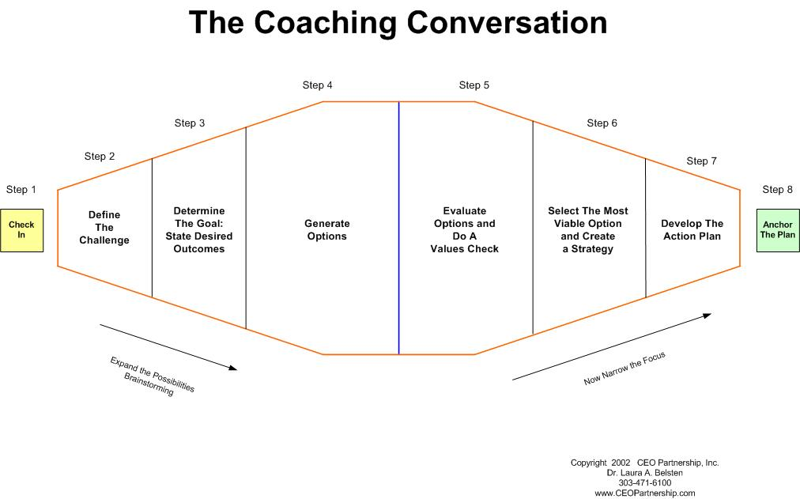
How did you do ?

Slide 83
A Model of Coaching

Slide 84
The DiSC
Understanding your communication and coaching style
A snapshot of how people give and receive feedback, communicate and coach
Not a personality profile or psychological tool; it measures behavior
Helps you identify your preferred style and the style preferred by others
Helps you build on your own strengths and the strengths of others
Helps you form better working relationships

Slide 85
D for Direct
  Action oriented
  Directive, decisive, assertive
  Strong willed
  Results focused, bottom line oriented
  Direct, you know where you stand
  Makes decisions quickly
  Visionary
  Fast paced
  Sometimes impatient, poor listener, bottom-line approach cuts people off, tends to dominate

Slide 86
I for Influence
  Fun, gregarious
  Energetic, animated
  Communicates easily
  An idea factory
  Thrives socially, talkative, outgoing
  Optimistic, persuasive
  Intuitive, empathic
  May have problems with follow-through, gets bored easily, may over-promise, would rather talk than listen, time & financial mgt issues

Slide 87
S for Steadiness
  Great listeners, caring
  “Champion” of others
  Open and honest
  Patient, deliberate
  Amiable, agreeable
  Dependable, supportive
  Stable, calm, sincere
  May put people over business, may not like risk taking or surprises, may slow progress out of need for harmony, overly sensitive to criticism

Slide 88
C for Conscientious
  Thorough, analytical, confident of facts
  Fair and unbiased
  Will take calculated risks, analytical
  Enjoys structure, adheres to high standards
  Careful decision maker
  Diplomatic (usually)
  Great follow-up and follow-through
  Persistent, bordering on perfectionistic
  May find it difficult to stop pursuing perfection, analysis paralysis, may overfocus on task, worries, may be slow to embrace change

Slide 89
Exercise
In groups by style preference, D i S or C, go to the four corners of the room and answer these questions for report out in 15 minutes:
  What are the key characteristics of your style?
  What is most important for others to know about working with your style?
  How does your style like to be coached?
  What questions would work well for your style?
  How does your style buy a gift?

Slide 90
Developing Others
The greatest good you can do another is not just share your riches, but reveal to him his own.
-- Benjamin Franklin

Slide 91
Developing Others
The heart of coaching
Set of skills designed to help others think rigorously, creatively and strategically.
It’s about “deepening the learning” and “forwarding the action.”
Generative inquiry, respectful listening and direct communication remain the foundation, but there’s more . . .

Slide 92
“The Ten Pillars”
Clarifying expectations
Brainstorming/strategizing
Planning and goal setting
Advising
Empowering
Challenging and requesting
Reframing
Supporting sustained action
Fostering accountability
Acknowledging/recognizing

Slide 93
Exercise
Ten groups (mix it up!)
Each takes a “pillar” – a “developing-others” skill or proficiency
15 minutes to review the skill and develop a role play, skit, scenario or other means to illustrate the skill to the rest of the group
5 minutes for each group to demonstrate the skill
The rest of the group has to guess which skill the small group is demonstrating

Slide 94
Coaching Practice: The “Ten Pillars” Skills + the Coaching Conversation
Groups of 3 (or 4)
Decide who will be coach, the person being coached (PBC), and observer(s)
PBC selects a current challenge or problem
Coach for 15 minutes, using the Coaching Conversation and the Ten Pillars skills
Observer(s) give 3 minutes of feedback
PBC gives 2 minutes of feedback
Switch roles, repeat.

Slide 95
A Model of Coaching

Slide 96
Providing Honest Feedback
Ongoing
Honest
Feedback ≠ Criticism
Fosters growth
Motivates
Builds confidence
Both positive AND constructive needed
Based on observation and analysis

Slide 97
Coaching Practice
Groups of 3 (or 4)
Rotate roles. If you haven’t yet coached, now’s the time. Decide who will be coach, PBC, and observer(s) for this role play
Review the scenario; prepare for the coaching conversation
Practice coaching for 15 minutes
Observer(s) give 3 minutes of feedback
PBC gives 2 minutes of feedback

Slide 98
Coaching Scenario: Honest Feedback
You are the Vice President of ABC Corp. You observe one of your employees working very effectively upwards with the other VPs, and the company President. They respect him, his expertise, his reports, his recommendations, and his insights, and they have also expressed to you that they appreciate his helpfulness. However, you have also observed that this individual has difficulty working with his direct reports and others in the department. He is often gruff and impatient with directs and other employees not at his “level” in the organization. With these folks, he seems to prefer to work alone, is not a team player, and withholds information. You are his supervisor and the only person on his immediate work team with whom he seems to be able to maintain a civil working relationship. His behavior is seriously impacting the performance of your department, and the organization as a whole, and the time has come for you to provide him with some feedback on his behavior. He has just completed making a successful report to the senior team (VPs and President), and then made snide and sarcastic comments about a peer at one of your team meetings.
How will you give him feedback?

Slide 99
How to do it:
Be specific
Be timely
Be sincere
Balance positive and constructive
Don’t judge
Don’t guess at motives
Avoid absolutes (“always” and “never”)
Prepare
Make it ongoing

Slide 100
Coaching Scenario: Honest Feedback
You are the Vice President of ABC Corp. You observe one of your employees working very effectively upwards with the other VPs, and the company President. They respect him, his expertise, his reports, his recommendations, and his insights, and they have also expressed to you that they appreciate his helpfulness. However, you have also observed that this individual has difficulty working with his direct reports and others in the department. He is often gruff and impatient with directs and other employees not at his “level” in the organization. With these folks, he seems to prefer to work alone, is not a team player, and withholds information. You are his supervisor and the only person on his immediate work team with whom he seems to be able to maintain a civil working relationship. His behavior is seriously impacting the performance of your department, and the organization as a whole, and the time has come for you to provide him with some feedback on his behavior. He has just completed making a successful report to the senior team (VPs and President), and then made snide and sarcastic comments about a peer at one of your team meetings.
How will you give him feedback?

Slide 101
Designing the Alliance
Build a bond of trust
Tune into other person’s view of the world
Generate awareness
Confidentiality & ethics

Slide 102
Tuning in to the Other’s “Worldview”
Why did you come to work here; what keeps you here?
Where do you want to be in three years?
What do you enjoy; what do you want to do more of?
What are your greatest challenges? How can I support you in overcoming those?
Do you prefer being given a specific set of directions, or do you prefer to create the plan yourself?
How do you prefer to be recognized for your work?

Slide 103
Generating Awareness
Quantitative and qualitative 360s
Other assessments (DISC, MBTI, others)
Encouraging self awareness
Encouraging social awareness

Slide 104
Confidentiality & Ethics
What gets discussed during coaching sessions remains within the coaching relationship. Period.
Candor + Tact = Effective Coaching (do no harm)
Give credit for the ideas generated by the person being coached
Other?

Slide 105
Developing Your Coaching Skills Further
Walk your talk by developing yourself
  Read books and articles on coaching
  Start a journal
  Work with a coach – experience coaching
  Create a culture that allows for risk and therefore, growth and development.

Slide 106
What did you learn today?
End-of-day reflection
Pages 76 - 81

Slide 107
THANK YOU !!!
If you have any questions in the coming weeks, please feel free to call or email:
Laura Belsten
303-838-1100
Laura @The-ISEI.com

