Slide 1


Slide 2
3P Consulting System
Randall Preiser
CEO, Preiser Consultants

Slide 3
“Something’s happening here, but you don’t know what is it is…do you, Mr. Jones?”
Bob Dylan

Slide 4

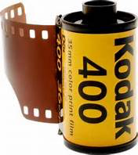
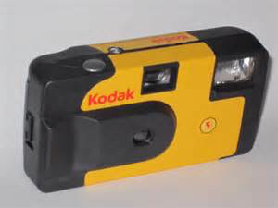

Slide 5


Slide 6


Slide 7
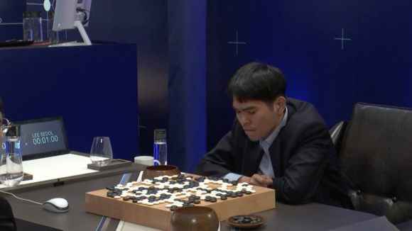

Slide 8



Slide 9



Slide 10


Slide 11
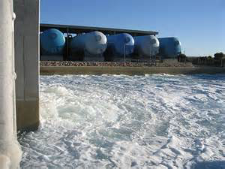

Slide 12
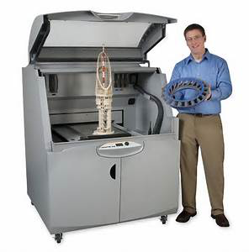
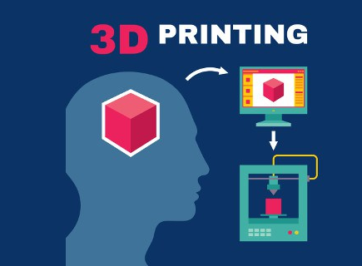

Slide 13




Slide 14
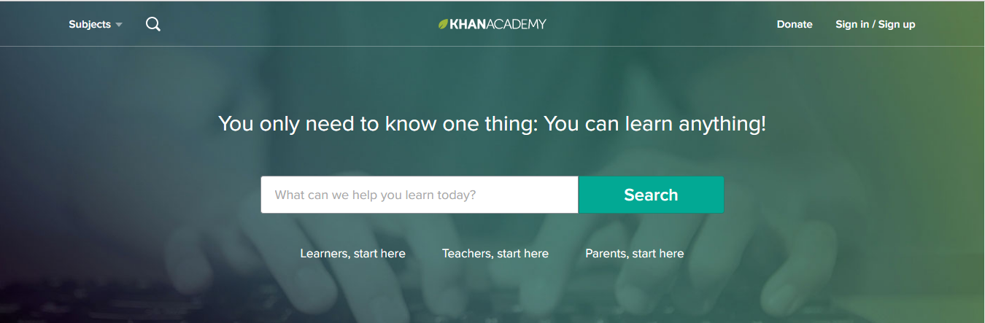


Slide 15




Slide 16
Coaching and Training Statistics
The Global Workforce Training Industry is at $306 Billion Annually
Currently Projected Growth of Consulting at 83%
Organization Coaching $11 Billion a year
Growing at $8 Billion a year
Personal/Executive Coaching is the 2nd Fastest Growing industry on the Planet

Slide 17

It’s Boom Time!
Organizational Training, Coaching, & Consulting

Slide 18
The Disruption in Organization Development
Not more technology, data, or information
Not more traditional training, lecturing, and cognitive development
Realization of the attributes
Organizations Need People Who:
  Are emotionally intelligent
  Are collaborative, can work naturally in Smart teams
  Able to think out of the box, take risks
  Can navigate in chaos, complexity, and uncertainty

Slide 19

Excited
Creative
Engagement

Slide 20
What You’re Going To Learn Today
3P Consulting System Overview
The Mindset, Toolset, and Skillset needed to be a successful Organization Development Consultant & Executive Coach

Slide 21
3P Consulting System Overview
Body of Knowledge

Slide 22
5 Step System to Attract, Create, & Serve Organizational Development Clients
Step 1: Generate an Inbound Inquiry
Step 2: Demonstrate client need through assessment
Step 3: Prepare a results-based proposal
Step 4: Appropriate executive and team-based interventions
Step 5: Discuss results with client and establish ongoing engagement

Slide 23
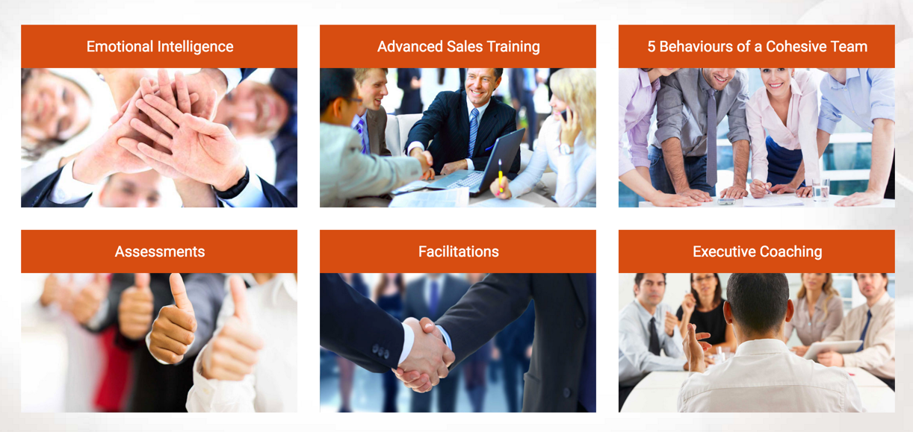
Website Template

Slide 24
Step 2: Complimentary Assessment
Step 1: Generate an Inbound Inquiry
Step 2: Demonstrate client need through assessment
Step 3: Prepare a results-based proposal
Step 4: Appropriate executive and team-based interventions
Step 5: Discuss results with client and establish ongoing engagement

Slide 25
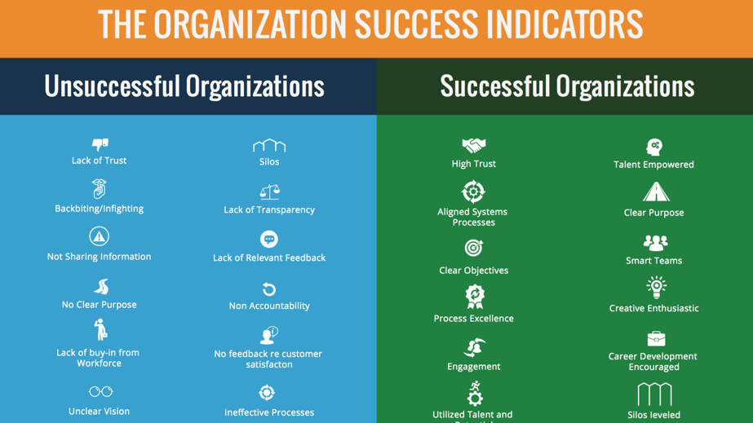


Slide 26
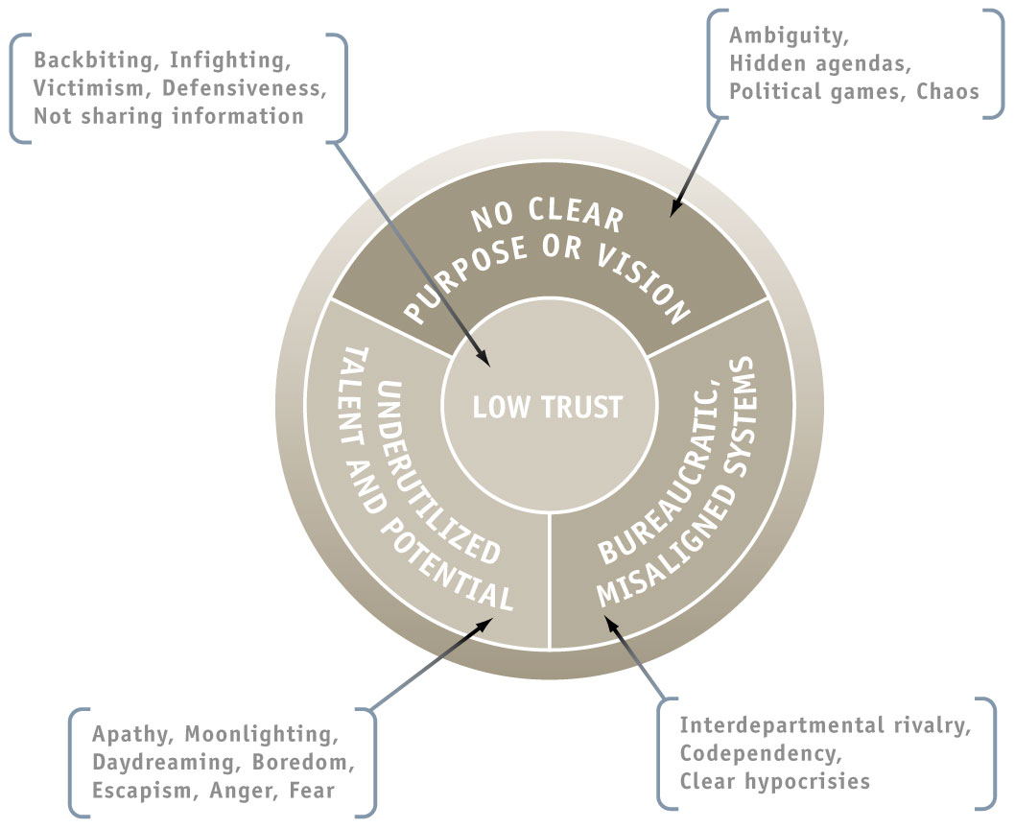

Slide 27
Step 3: Results-Based Proposal
Step 1: Generate an Inbound Inquiry
Step 2: Demonstrate client need through assessment
Step 3: Prepare a results-based proposal
Step 4: Appropriate executive and team-based interventions
Step 5: Discuss results with client and establish ongoing engagement

Slide 28
Step 4: Executive and Team Interventions
Step 1: Generate an Inbound Inquiry
Step 2: Demonstrate client need through assessment
Step 3: Prepare a results-based proposal
Step 4: Appropriate executive and team-based interventions
Step 5: Discuss results with client and establish ongoing engagement

Slide 29
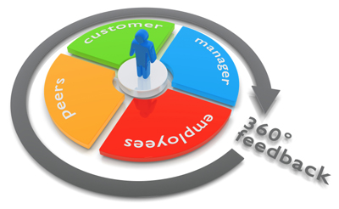

Slide 30
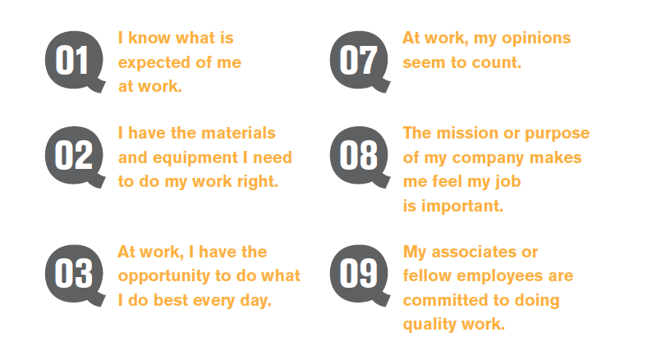
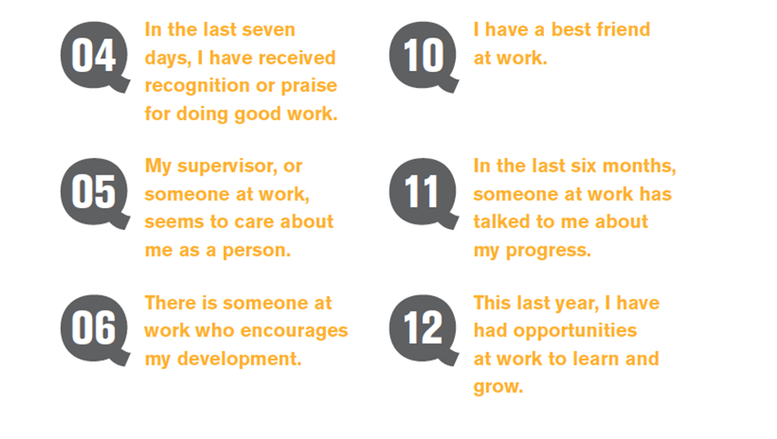
Gallup 12® Employee Engagement

Slide 31
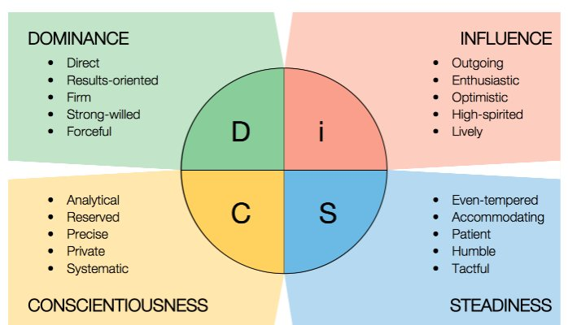
DiSC Workstyle Indicator

Slide 32


Smart Team Games

Slide 33
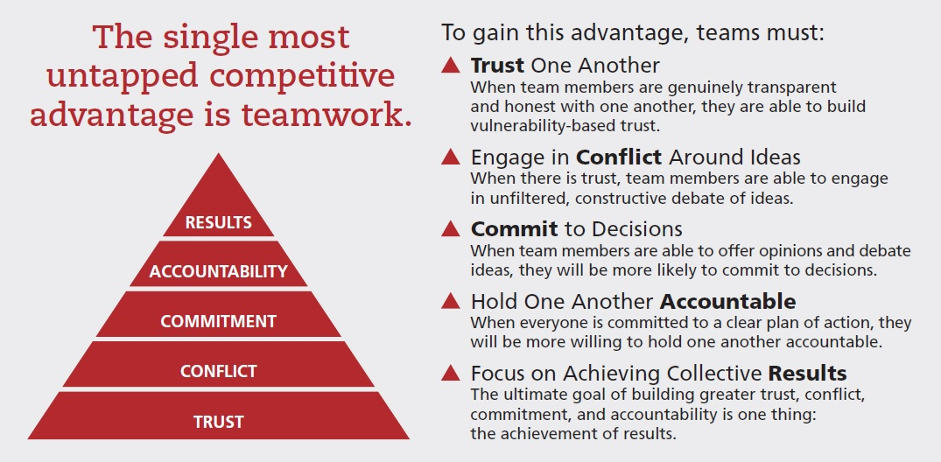

Slide 34
Step 5: The 3P Consulting Rapid Results System
Step 1: Generate an Inbound Inquiry
Step 2: Demonstrate client need through assessment
Step 3: Prepare a results-based proposal
Step 4: Appropriate executive and team-based interventions
Step 5: Discuss results with client and establish ongoing engagement

Slide 35
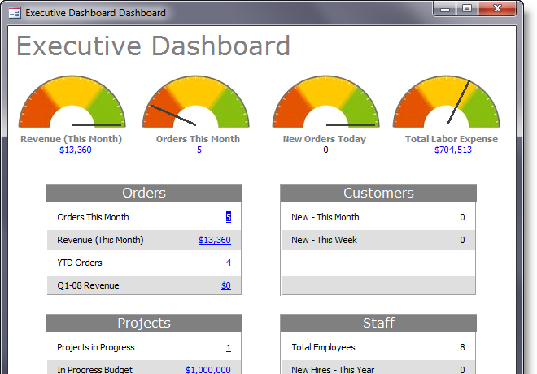

Slide 36
Mindset, Skillset, Toolset

Slide 37
The Mindset
Outside In vs. Inside Out
The Principles behind Clarity
The 4 Imperatives of an Authentic Leader
The Four Dysfunctions of an Organization
The 5 Behaviors of a Cohesive Team

Slide 38

Jamie Smart, Clarity. www.ClarityBook.biz

Slide 39
100% of the time…….
We are living in the feeling of our thinking!
You are experiencing
this right now.

Slide 40
Our experience of Reality is coming from our thinking in this moment.

Slide 41
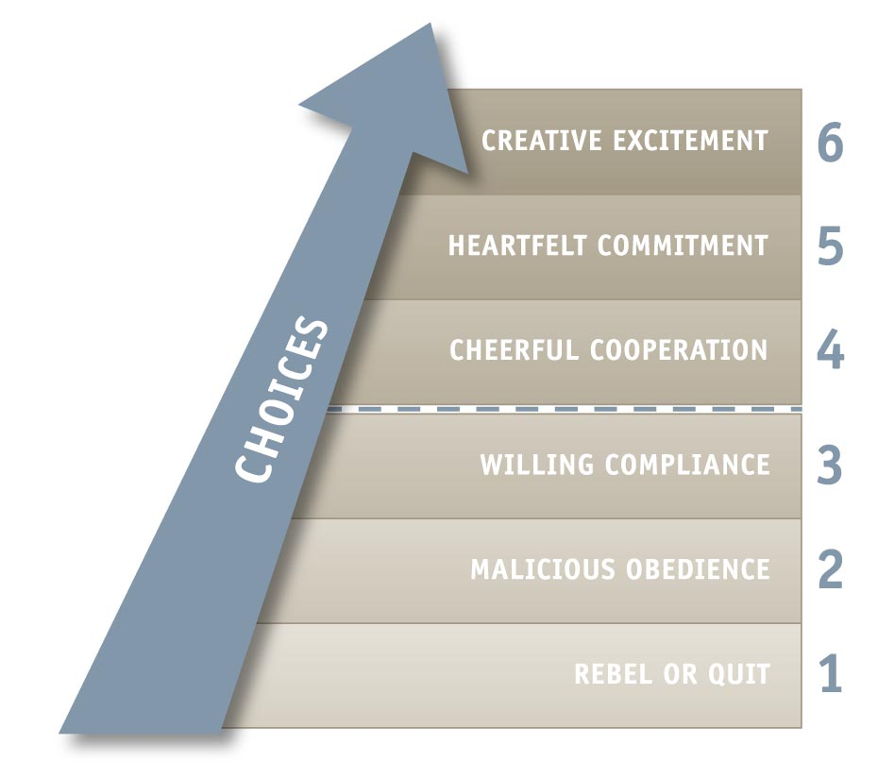
Levels of Engagement

Slide 42
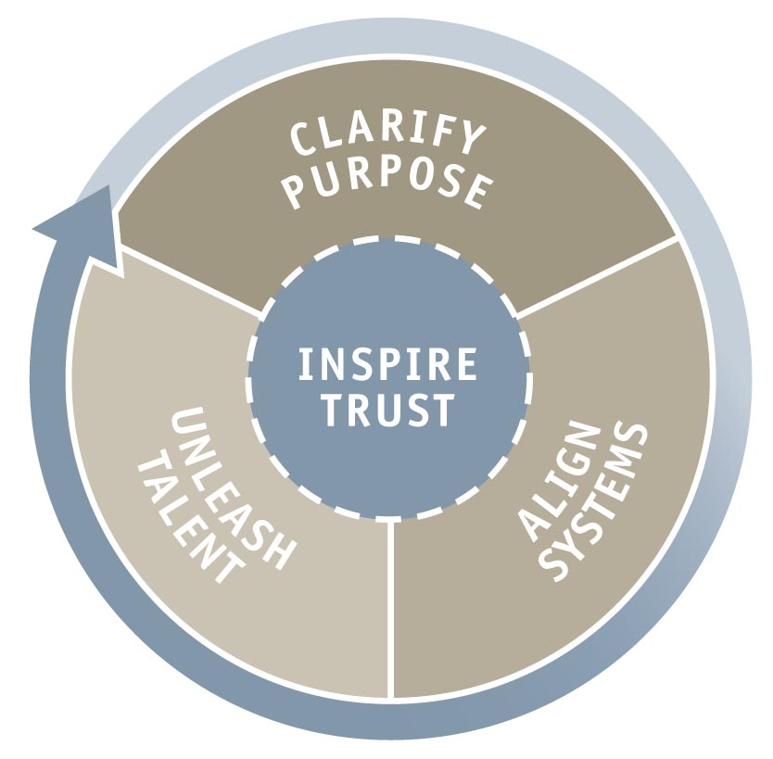

Slide 44
The Toolset
DiSC Type Indicator
360 Multi-rater
Gallup 12 Survey
Smart Team Games

Slide 46
The Skillset
Facilitation
  SIOP
Coaching
  3P Executive Coaching
Training
  The Leader as Coach

Slide 47

The 4 Keys to Bringing About Transformation via Executive & Team Coaching
Key 1: Determine Objectives
Key 2: Examine Causes
Key 3: Facilitate Understanding
Key 4: Plan of Action

Slide 48

The Leader as Coach
Presented by Randall Preiser

Slide 49
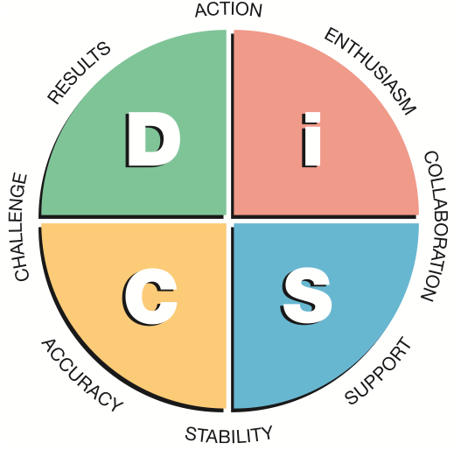
DiSC

Slide 50
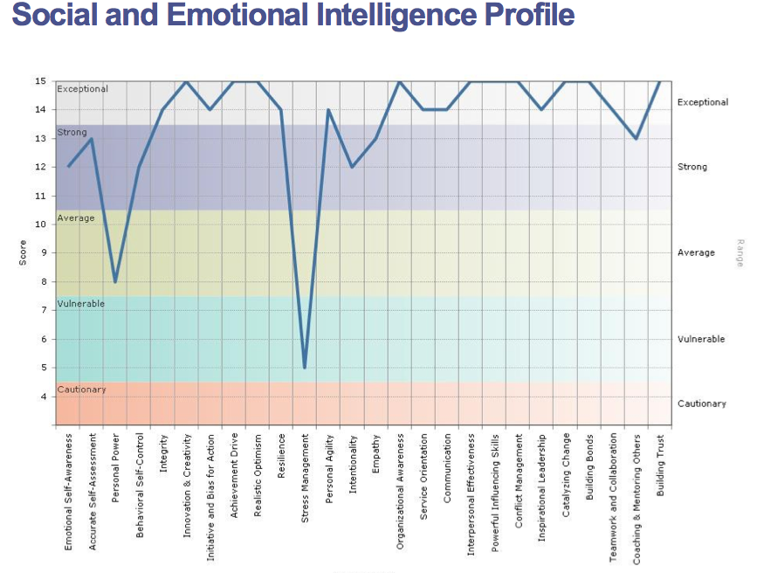
Social and Emotional Intelligence Profile

Slide 51
What You Learned Today
3P Consulting System Overview
The Mindset, Toolset, and Skillset needed to be a successful Organization Development Consultant & Executive Coach

Slide 52
What You Learned Today
The 5 Step System to attract, close, and serve Organizational Development Clients
The 4 Keys to bring about transformation via Executive Coaching

Slide 53
5 Step System to Attract, Create, & Serve Organizational Development Clients
Step 1: Generate an Inbound Inquiry
Step 2: Demonstrate client need through assessment
Step 3: Prepare a results-based proposal
Step 4: Appropriate executive and team-based interventions
Step 5: Discuss results with client and establish ongoing engagement

Slide 54
The 3P Consulting System - Review
12 Weeks Live Coaching/Training
Members-Only Website
Full Document and Tools Library
Marketing Templates
Private Facebook Coaching Group

Slide 55
What’s Included
DiSC profile online portal /training
360 Leaders Profile/training
Emotional Intelligence assessment/training
5 Behaviors Facilitation Program
“Leader As Coach” training and materials
Website template
Social Media consulting
Lead generation magnet

Slide 56
What Else Is Included
Sample proposals/contracts
Surveys
Smart Team Experiential Games
Case Supervision
Coaching to achieve clients
Coaching tools kit

Slide 57
More included
Skills training Facilitation/Executive Coaching, Administration of Assessments
Evaluation Forms
Important Links
List of Professional Associations
Additional Resources

Slide 58
Special Bonus
2 one-on-one Coaching sessions with RP
Extra DiSC Workplace Profile

Slide 59
Recommended Reading
Clarity by Jamie Smart
The 4 Imperatives of Great Leaders by Stephen Covey
Instant Motivation by Chantelle Burns
The Five Dysfunctions of A Team by Patrick Lencioni

Slide 60
Questions & Answers

Slide 61

Thank you!
Randall Preiser, CEO
Preiser Consulting
www.3PConsultingSystem.com

