Slide 1

Business Development
Part 1
3P Consulting System

Slide 2

What You’re Going To Learn Today
The current business opportunity that exists for organizational development
How to identify and capitalize on added value strategies
The value of a revenue stream and how to create one

Slide 3

3P Consulting System
Follow the $...

Slide 4
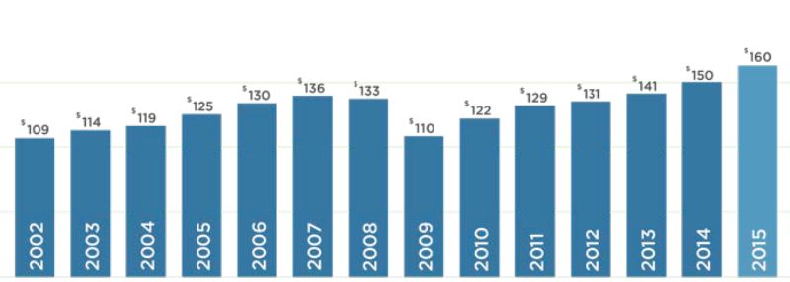
Corporate Training Spend in North America*
[In Billions of Dollars]
*Global spend = $355.6B
Training Industry, Inc. 2016

Slide 5
Why Organizations Outsource Training
Training Industry, Inc. 2016

Slide 6
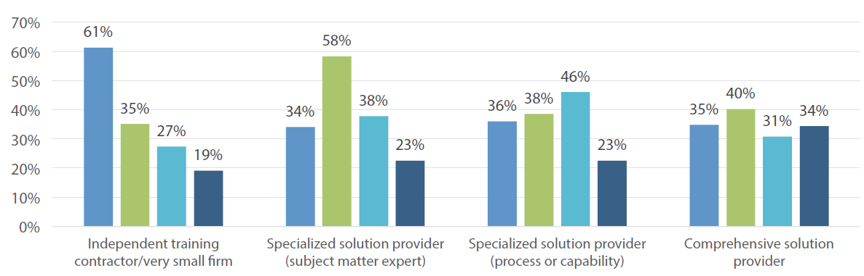
Organizations Trust Experts Like You
■ Content services (eg, design, materials fulfillment)
■ Delivery services (eg, instructor, facilities)
■ Learning technology product/services (eg, LMS management, delivery platforms, authoring tools)
■ Administrative services (eg, scheduling, financials, planning)
Training Industry, Inc. Research. 2016.

Slide 7
Trending Topics
Leadership
Communication
Conflict Management
Emotional Intelligence
Health & Wellness
Mindfulness
Workplace Stress
Creativity & Innovation
Presentation Skills
Executive Presence
Productivity
Critical Thinking
Women in Leadership
Managing Chaos
Business Writing
Generations
Diversity & Inclusion
Negotiation Skills
Influencing Up
Project & Change Management

Slide 8
Revenue Projections
63% of small business owners
with corporate clients
earn $500,000 OR MORE per year.
Source: Center for an Urban Future 2012.

Slide 9

Rapid Growth
Within 2 years of engaging a first corporate client,
small business owners see an average
revenue increase of 266%.
Source: US Census

Slide 10

Case Study #1: Executive Coaching
Topic: Dealing with conflict and creating clear vision
Audience: 8 senior-level managers (non-profit organization)
Length of engagement: 4.5 hours
Deliverable: ½ day session
Original Contract Value: $6,500
Added Value Strategy: 30-day post session discussion facilitation
Added Value Opportunity: 1 half-day training per quarter would add $26,000 in annual revenue

Slide 11
Case Study #2: Business Coaching
Topic: Leadership, Mindset, and Communication
Audience: 20-40 participants
Length of engagement: Four, 8-hour days
Original Contract Value: $32,000
Added Value Strategy: Limited class size to 20; $350 for each additional participant – added an additional $14,000 in revenue
Added Value Opportunity: One 2-day training every quarter would add $64,000 in annual revenue

Slide 12

Get in the Flow with an Income Stream
Get paid to:
Deliver content
Create content
Teach your client how to deliver your content
Let your client continue using your content
Let the client record your training and share it
Teach other experts your expertise
Let others teach your content to their clients

Slide 13

Get Paid More For
Customization
Multiple bookings
Limited class size
Focus groups
Stakeholder interviews
Assessments
Advanced training
One-on-one sessions
Small group intensives
Facilitated discussions and Q&A
Experiential learning & excursions
Book packages

Slide 14

Case Study #3: Executive Coaching
Topic: Leadership, Communication, & Performance
Audience: 9 VPs
Length of engagement: 6 months
Deliverables:
  Four assessments per participant
  One 45-minute coaching session per month/pp (by phone)
  One ½ day training workshop per month x 6 months
  Pre and post-coaching program debriefs with management
Original Contract Value: $183,500
Added Value Strategy: Small group intensives; added an additional $30,000 in revenue

Slide 15
Case Study #4: Leadership Coaching
Topic: Inspiring managers to be better leaders
Audience: 150 managers
Length of engagement: 45 minutes
Deliverable: Keynote
Original Contract Value: $10,000 + travel expenses
Added Value Strategy: Book package; added an additional $4,000 in revenue
Added Value Opportunity: 1 large group training per quarter would add $40,000+ in annual revenue

Slide 16
Questions & Answers

