Slide 1

Business Development
Part II
3P Consulting System

Slide 2

What You’re Going To Learn Today
The difference between active and passive business development
How to prioritize your business development efforts
Where to find new clients
How to prepare for and conduct an effective face-to-face client meeting

Slide 3


The Heart of Business Development
“If people like you, they'll listen to you, but if they trust you, they'll do business with you.”
~ Zig Ziglar
What are you doing each day to
earn your customers’ trust?

Slide 4
Outbound Vs. Inbound Contacts
Target Clients
Speaking
Introductions
Direct Contacts
New Leads
Published Content
Social Media
SEO

Slide 5


Proactive vs. Passive Business Development
Outbound (proactive)
Inbound (passive)
Speaking / Follow-up from Speaking
Requesting Introductions
Follow-up from Centers of Influence
Follow-up from Webinars
Direct Prospecting (phone, email)
Follow-up from strategic networking
Follow-up from Sponsorships & Exhibits
Personal visits
LinkedIn Profile
Publishing Articles
Online Opt-In + Nurture
Paid Advertising
Insight / Content Marketing
Unsolicited Referrals
Traditional Media & Social Media
Website

Slide 6

The Pareto Principle at Play
Greater than 80% of your revenue will come from outbound, proactive business development efforts.

Slide 7
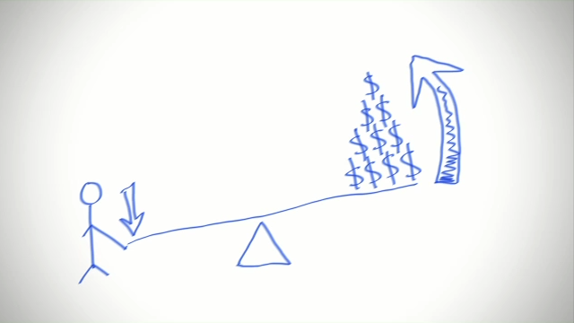
Leverage Your Time Wisely
Prioritize Your Efforts
Activate Existing Relationships
Leverage Visibility to Cast a Wider Net
Execute an Account Strategy

Slide 8
Priority #1. Activate Existing Relationships
Current clients
Past clients
Strategic introductions and referrals

Slide 9
Priority #2. Leverage Visibility to Cast a Wider Net
Speaking engagements
Centers of Influence
Strategic networking
Small, in-person experiences

Slide 10
Priority #3. Execute an Account Strategy
Client entry campaign with target number of organizations (25-50)
Mix of introductions + high proximity visibility strategies
Customized email nurture campaign

Slide 11

Presence and Visibility
Do your target clients know you exist?
Do they know how to find you?
Do they know when they need you?
Do they know they need you?

Slide 12
Market Reality
3%
Active Buyers
30% Do Not Have a Need (yet)
30% Are Not Interested (yet)
7% Intend to Act Soon
30% Have a Need, but are not yet ready
Jeremy Miller. Sticky Branding. Adapted.

Slide 13

Timing IS Everything
The right time is when your client is ready.
What can you do to ensure you are the expert resource and top of mind when your client is ready?

Slide 14

Do You Want More Client Prospects?
You can pursue as many as you are willing to!
“Lack of leads” is a self-limiting myth you can cross off your list today.

Slide 15
Who Invests in Organizational Development?
Coaching
Training
Facilitation
Business Decision Makers
Procurement
Human Resources
CEOs
Business Owners

Slide 16

Where do they look?
In their database of contacts
To their colleagues for a referral
To other contracted experts in the field
Experts they’re already working with
To individuals they’ve already met
To individuals/sources who are top of mind

Slide 17

Human Resources
Training Departments
Organizational Development Directors
Why do They Need You?
  Not enough staff
  Not the right staff/expertise
  Not enough time
  Many other reasons!

Slide 18
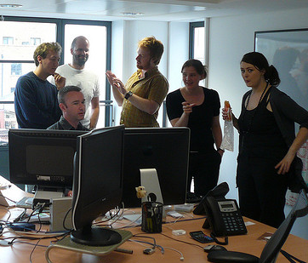
Business Decision Makers
CEOs, Business Owners
Chief Learning Officers, Chief Operating Officers
Division Directors, Project Managers, etc.
Why do They Need You?
  Avoid political issues
  Scope or scale of need too large
  Need objectivity of third party
  Corporate directive
  Many other reasons!

Slide 19

Procurement
Purchasing, Corporate Buyers
Supply Management, Supply Diversity
Why do They Need You?
  Very large corporations
  Following competitor trends
  To ensure fairness
  Many other reasons!
Be Aware! Procurement is system-driven; often requires strategic connections and memberships

Slide 20
Business Development Equation
Proximity + Follow Up = High Growth

Slide 21
Proximity Activities (High to Low)
Speaking
Executive Roundtables
Power Breakfasts
Power Lunches
Strategic Introductions
Sponsoring
Exhibiting
Networking
Go-See’s
Webinars

Slide 22
Conversations Create Clients
Do you speak the same language as your clients?
Follow industry news
Local and world events
Business journals

Slide 23

Client Conversations
Strategies for Communicating Value

Slide 24
Client-Requested Meetings - SPECIFIC
How to Begin
What to Focus On
Begin by discussing a relevant success you have had with the outcome or situation the client has an interest in
Needs discovery

Slide 25
Client-Requested Meetings - GENERAL
How to Begin
What to Focus On
Discuss meeting expectations
Be specific! Ask:
“What would be the best use of our time today?” or “What would you like to accomplish by the time we finish our meeting?”
Needs discovery

Slide 26
Meetings that You Initiate with a Client
How to Begin
What to Focus On
Provide something of value to your new potential client
Overview your capabilities
Inform, don’t “sell”
Your firm’s capabilities

Slide 27
Needs Discovery
Getting to Know Your Client
What prompted their contact with you or their agreement to meet with you?
What is their timeframe for achieving their desired outcome(s)? What is driving those dates?
Are you meeting with a decision maker?
  A decision maker is someone who can say “yes” to move forward with an engagement, has the entire budget authority for your proposed work, and does not need to seek approval from anyone else in order to do so.

Slide 28
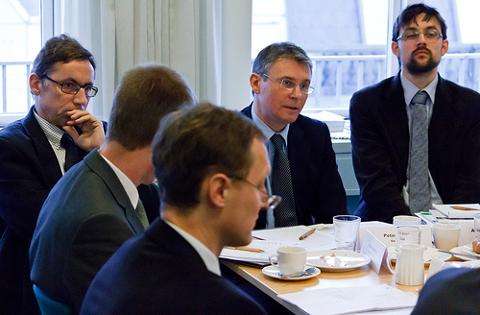
Your First Client Face-to-Face
Don’t request more than 1 hour of their time
Clarify who will be attending
Be clear about logistics (date, time, place)
DO NOT BE LATE
Prepare!

Slide 29

Client Baseline Data
Who are their customers?
What is their revenue model?
What is their annual revenue?
Who is their CEO?
What does their organizational structure look like?
How many employees?
Geographic locations/multiple sites?
Latest news announcements?

Slide 30

Prepare for the Meeting
Be familiar with your potential client’s space:
  Website and press releases
  Google search
  LinkedIn page
  Other social media accounts

Slide 31
Needs Discovery Meeting

Slide 32

Setting the Stage
Greetings, begin rapport building
Introductions
Clarify roles for meeting as well as for go-forward
Double-check time availability for entire scheduled meeting
Restate meeting goal; negotiate any differences

Slide 33
Where is Your Client?
3%
Active Buyers
30% Do Not Have a Need (yet)
30% Are Not Interested (yet)
7% Intend to Act Soon
30% Have a Need, but are not yet ready
Jeremy Miller. Sticky Branding. Adapted.

Slide 34

Needs Discovery
What is the problem, challenge, or pain your client is experiencing?
What do they believe is causing the problem? Are they correct?
What are some of the repercussions (collateral damage) of the problem?
What is their vision for a perfect future?
What is their most immediate need?
What is driving any sense of urgency?
What is the problem currently costing them? (dollars, people, reputation, etc.)

Slide 35
There’s More to Discover…
Are you and the client on the same page?
How interested are they in moving forward?
Are they able to make the buying decision?
What does the client’s buying process look like?
Who else, if anyone, needs to be involved?
What would it look like if you were to work together (roles, deliverables, etc.)?
Is the client ready to move make the investment and move forward at this time?

Slide 36

Secure the Engagement
Get agreement to discuss specific solutions
Share ideas/test their interest
Confirm the client’s level of interest
Set clear financial expectations
Determine decision making authority
Discuss a realistic time frame
Address risk
Close on a strong note

Slide 37
All Problems Can Be Quantified
People
Product
Profit
Process
What is it costing you?
What if you do nothing?
How much are you losing?
What is the effect on your staff?

Slide 38

Avoid These Common Mistakes
Contaminated thinking
Not managing time
Losing control of the meeting
Reacting without pausing
Making agreements you shouldn’t
Not discussing money
Believing without questioning
Not digging deeper
Failing to get agreement at each stage of the conversation
Leaving/ending without clear next steps
Not asking for the business

Slide 39

How to Respond to ANY Difficult Question
Pause – Silence is OK
Breathe
Respond with, “Let me think about that for a minute.”
Decide whether the question makes sense
Don’t feel obligated to respond
Ask for clarification if appropriate

Slide 40

Listen for the Why…
Why your potential client is asking for help
Why your potential client is hesitating
Why your potential client isn’t saying yes to moving forward

Slide 41

Common Reasons You Won’t Hear Yes
Internal disagreement about the problem, approach to solving it
Decision makers not involved
Not enough support or internal buy-in
Can’t get funding approved
Lack of clarity
Shift in priorities
Urgency dissipates

Slide 42

Closing Your Meeting
Always end with clearly identified next steps.
This helps keep the relationship and project momentum moving forward.
Without it, the majority of leads end here!

Slide 43

Presenting Your Proposal
Always present your proposal in person
If necessary, review it with your client via videoconference
This ensures:
It is presented fully and correctly
You are the one representing your business to the decision maker(s)

Slide 44
Questions & Answers

