Slide 1

Mindset of the Coach and Organization
3P Consulting System

Slide 2

What You’re Going To Learn Today
The coach’s mindset (that’s you!)
  Thought, Consciousness, & Mind
  The Clarity™ Results Model
Measuring and improving:
  Four essentials of a healthy organization
  Five critical organizational behaviors
  Ten team engagement factors

Slide 3
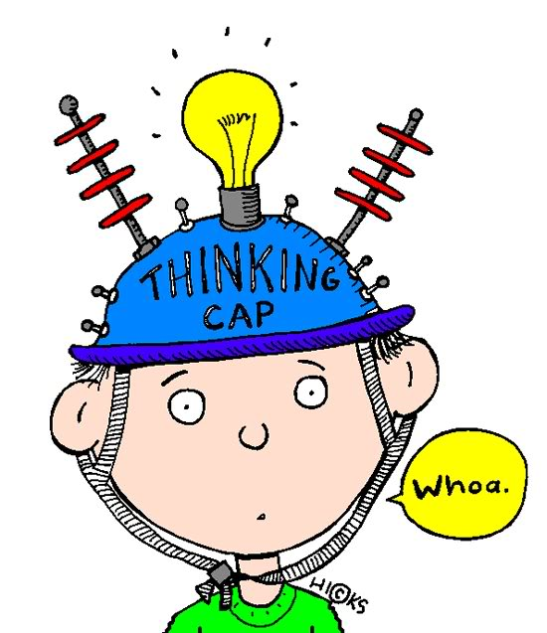
The 3 Principles
The Coach’s Mindset

Slide 4

3 Principles of Clarity
Thought – The reality principle
Consciousness – The experience principle
Mind – The power principle
Banks, 1974. Smart, 2013.

Slide 5
Thought
Our innate capacity to generate a perceptual reality
The source of the thoughts and perceptions we experience each day
Analogous to a computer processor
The reality principle

Slide 6
Consciousness
Our capacity to have the experience of thinking
It brings our thought-generated reality to life
Analogous to a computer screen
The experience principle

Slide 7
Mind
The power source of life
The origin of any being
Analogous to a computer’s power supply
The power principle

Slide 8

You’re built for reality;
You’re optimized for results.

Slide 9
Deep Drivers: Innate Leadership Qualities
Thought, Consciousness, Mind
Direction | Motivation, Passion purpose, Vision
Resilience | Agility, Mental toughness, Rapid recovery
Creativity | Strategy, Innovation, Problem solving
Authenticity | Authentic leadership, Integrity, Differentiation
Intuition & Wisdom | Opportunity spotting, Good decisions, Sustainable solutions
Presence | Responsiveness, Influence, Embodied learning
Connection | Contribution and caring, Strong relationships
Clarity & Peace of Mind | Aligned with reality, Insight, High performance
DD
Smart, Jamie. Results. 2016. Capstone.

Slide 10



The Clarity™ Equation
Clarity = Capacity - Contamination

Slide 11

“100% of your feelings come from thoughts
being formed in the moment.”
Jamie Smart

Slide 12



The Clarity™ RESULTS Model
Clarity + Action = RESULTS
Smart, Jamie. Results. 2016. Capstone.

Slide 13
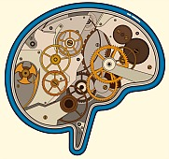
Organizational Function
A Mindful Approach to Assessment

Slide 14

Five Critical Organizational Behaviors
Trust
Healthy conflict
Commitment
Accountability
Positive outcomes (results)
Lencioni 2002

Slide 15
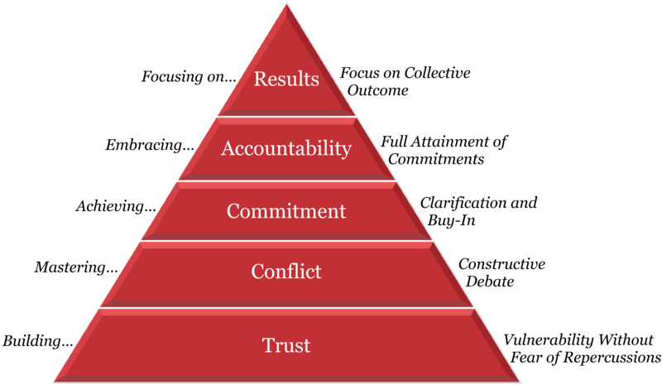
Lencioni 2002

Slide 16

Trust
High trust in an organization speeds things up and decreases cost
Low trust slows things down and increases cost
Total return to shareholders for organizations with high trust is almost 3X higher than that of organizations with low trust.*
*Watson Wyatt 2002.

Slide 17
Healthy Conflict
Healthy conflict:
  Focuses on issues and topics, not on people or their character
  Indicates that team members are engaging in unfiltered, constructive debate of ideas
  Fosters team and organization growth

Slide 18
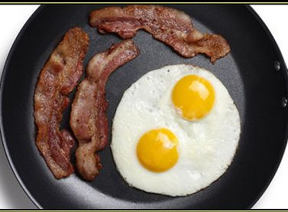
Commitment
The chicken was involved; the pig was committed.
Commitment enables teams to:
  Clarify priorities and decisions
  Share in common objectives
  Move forward without second-guessing
  Learn from its mistakes
  Change direction without hesitating or feeling guilty

Slide 19
Accountability
Signs of Accountability
Benefits of Accountability
Team members know when they’re doing a good job
Feel OK about owning their shortcomings and are receptive to suggestions
Feel an increased sense of belonging to the team
Identifies and solves problems quickly and efficiently
Establishes mutual respect among team members who are all held to the same expectations
Pressures poor performers to improve
Avoids corrective action bureaucracy

Slide 20
Positive Outcomes (Results)
Teams that focus on results:
  Focus on group performance, not the individual
  Attract and retain more achievement-oriented thinkers
  Reap the benefits from team players who put the needs of the group first
  Don’t get easily sidetracked by non-mission critical issues

Slide 21

Four Essentials of a Healthy Organization
Clear mission
Process integration
Maximize potential
Promote trust

Slide 22
Clear Mission, Vision, and Purpose
What Happens Without it?
Ambiguity
Hidden agendas
Political games
Chaos
Knowledge workers
  Regarded as associates and partners
  Given autonomy
  Self motivated
  Whole person paradigm
Teams must not only understand, but be provided an opportunity to contribute to the mission of an organization
  Body, Heart, Mind, Spirit

Slide 23
Process Integration
The systems and processes in an organization are directly correlated with its mission and outcomes.
Key systems that must be aligned include:
  Leadership
  Strategy
  Customers
  Data and Knowledge Management
  Workforce
  Operations
What Happens Without it?
Interdepartmental rivalry
Codependency
Clear hypocrisies

Slide 24
Maximize Potential
A high performance culture is the desired goal. This begins with leaders who listen and act accordingly.
Employees benefit when they have:
  Support for their strengths and potential
  Clear expectations
  An advocate for their success
What Happens Without it?
Moonlighting
Daydreaming
Apathy, Anger
Escapism, Fear

Slide 25
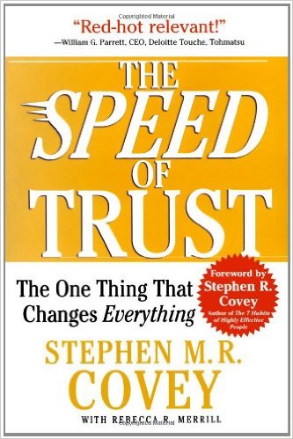
Promoting Trust in an Organization
Inside Out
Outside In
DD
Trust comes from clarity and connection
Subtractive process in which communication barriers and superstitious thinking are removed
Takes effort of both parties
Memorization and application of methods

Slide 26
Factors of Employee Engagement
Employees have:
Materials/equipment to do their job
The opportunity to do their best
Receive weekly praise or recognition
Receives regular encouragement
An opportunity to discuss their progress at least 2x/year
Annual learning and growth opportunities
Feels cared about as a person
Feels their opinions matter
Believes their coworkers are committed to quality work
A best friend at work to share their experience
The Gallup Organization

Slide 27
Why Engagement Matters
Organizations with highly engaged employees had an average 3-year revenue growth 2.3 times greater than those whose employees showed average engagement.*
Results in better business outcomes
Higher productivity
Increased efficiency
Higher levels of customer satisfaction
*Schaufenbuel, K. (2013). Powering your bottom line through employee engagement. UNC Kenan-Flagler Business School.

Slide 28

Organizational Needs Assessment
Tools for the Coach

Slide 29
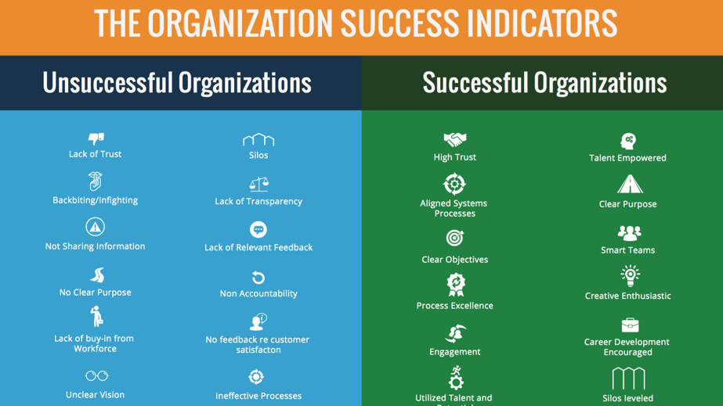
Organizational Success Indicators
Easy-to-use infographic
For use in all sectors
Any size organization/structure
Helps spot vulnerable areas
Mines development opportunities

Slide 30
Highlights of a Successful Organization
Customer centric
Always learning
Listens to employees and customers
Rewards good performance
Innovative
Continuously improving
Clear sense of direction
Open communication
Collaborative environment
Embraces quality
Promotes transparency
Adaptable and agile
DD

Slide 31
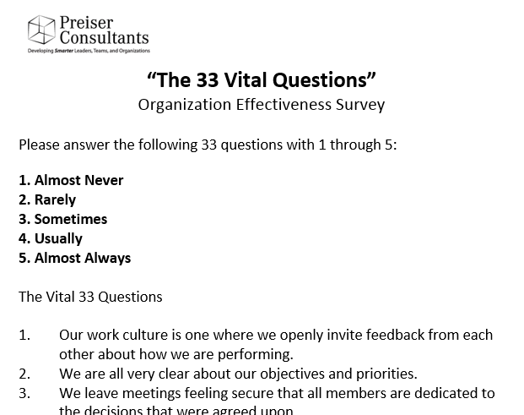
The Vital 33 Questionnaire
Used to assess organizational effectiveness
Based on mindset principles
Can be administered hard copy or online
For use in all sectors
Any size organization/structure

Slide 32
Vital 33 – Sample Questions
We have clear measures that track our progress on key performance indicators.
We routinely use feedback from our customers to improve our performance.
I know what is expected of me at work.
It is easy to talk with our leaders if something goes wrong.
We often challenge existing practices with creative alternatives.

Slide 33

Organizational Function At A Glance
This graphic depicts the essentials of a healthy organization.
All the critical behaviors and team engagement factors can be categorized into one of these areas.
The Organizational Success Indicators and Vital 33 Questions are tools used to measure performance in these 4 areas.
Clear Mission
Process Integration
Maximize
Potential
Trust

Slide 34
Putting it all Together
The 3 Principles of Clarity mark the work of the coach at every stage:
C
C
C
The Coach’s Mindset
New Organizational
Client
Interventions
Clarity RESULTS Model
Executive coaching
Facilitation
Training
Four essentials
Five critical behaviors
Team engagement
Organizational Success Indicators
Vital 33 Questions

Slide 35
What You Learned Today
The coach’s mindset
  Thought, Consciousness, & Mind
  The Clarity™ Results Model
Measuring and improving:
  Four essentials of a healthy organization
  Five critical organizational behaviors
  Ten team engagement factors

Slide 36
Questions & Answers

