Slide 1

Emotional Intelligence
3P Consulting System

Slide 2
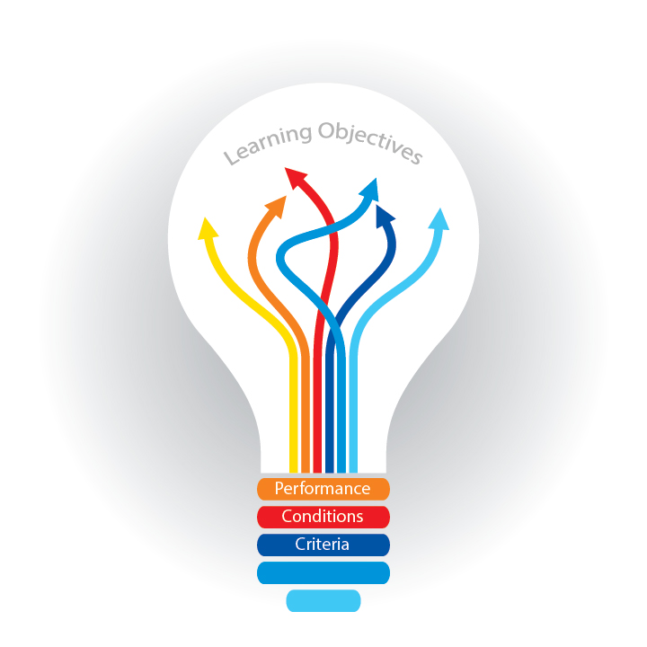
What You’re Going To Learn Today
  What is Social and Emotional Intelligence (S+EI)?
  A brief history of the field
  Why does S+EI matter?
    In organizations
    In our personal lives
  The science behind S+EI
  Review of the four quadrant model of S+EI
  The EIQ-2 assessment instrument

Slide 3
What is Social and Emotional Intelligence?
A Working Definition
Social and emotional intelligence is the ability to be aware of our own emotions and those of others, in the moment, and to use that information to manage ourselves and our relationships.

Slide 4
S+EI Four-Quadrant Model
Self Recognition
Understand own moods and emotions
Social Recognition
Develop a rapport with new people
Social Management
Understand others’ emotions; treat them as they wish to be treated
Self Management
Control over emotions; think before acting

Slide 5
S+EI is about behavior
(and behavior can be changed)
Genetics
Personality
Behavior
Environment

Slide 6
Building Blocks of Behavior
Behavior
Emotions
Thoughts

Slide 7
A Brief History of S+EI
Abraham Maslow & Humanistic Psychology
Ohio State studies on ‘task’ vs. ‘consideration’
1985 Wayne Payne: “Emotional Intelligence”
1987 Keith Beasley: “Emotional Quotient”
(“EQ”) in Mensa
1990 Peter Salovey & John Mayer journal article on EI
Howard Gardner’s “Theory of Multiple Intelligences”
Edward Thorndike’s “Social Intelligence”
EQ
1900
1918
1930
1950
1958
1983
1987
1995
2006
2011
1985
1990
Alfred Binet administers intelligence tests to French school children
First large scale administration of IQ tests to US Army recruits
1995 book Emotional Intelligence by Daniel Goleman popularized EI
2006 two books on “Social Intelligence” by Goleman & Karl Albrecht
IQ
David Wechsler develops WAIS (Wechsler Adult Intelligence Scale)
Concepts of intelligence have evolved over the last 100+ years

Slide 8
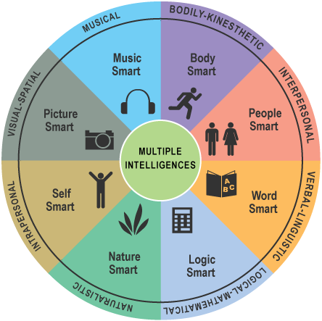
History of S+EI, continued
Howard Gardner: Frames of Mind (1983)
Seven new categories of intelligence:
  Verbal/linguistic
  Logical/mathematical
  Visual/spatial
  Musical
  Bodily/kinesthetic
  Interpersonal
  Intrapersonal

Slide 9
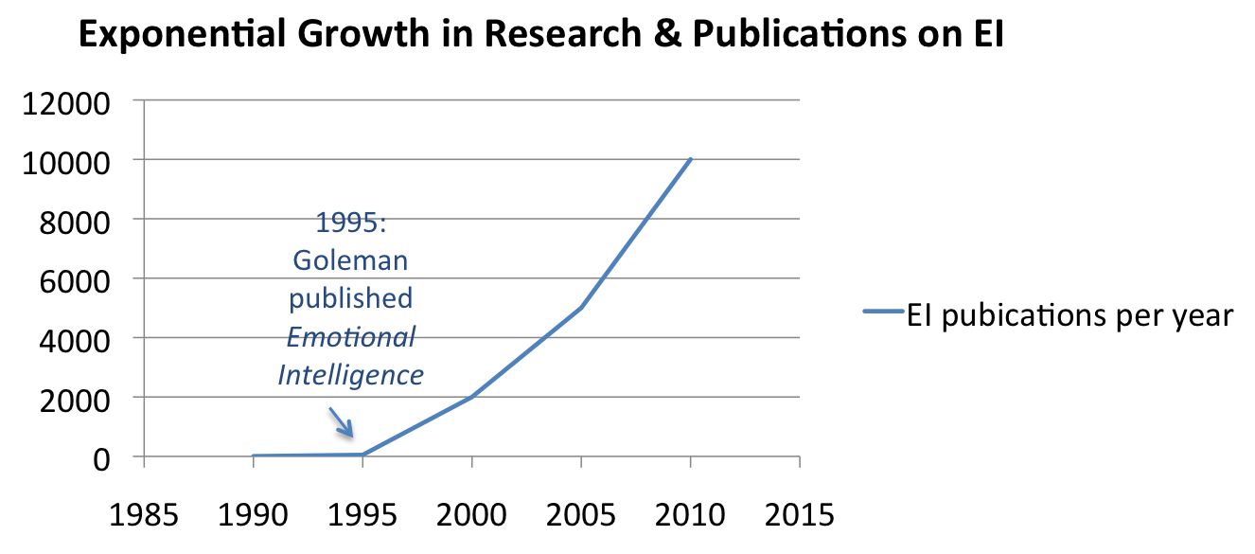
History of S+EI, continued
1990:
Salovey & Mayer coined the term “Emotional Intelligence”
1998:
Goleman published
Working with Emotional Intelligence

Slide 10
Evidence that Soft Skills Matter
Employees
Job satisfaction
Businesses
Retention
Work climate
Personal
Healthier relationships
Less drug and alcohol use
Customer satisfaction
Market share
Revenue
Sales
Competitiveness
Profits
Less violence
Better health
Quality of life
Longevity
Performance
Teamwork
Conflict resolution
Productivity

Slide 11





















S+EI Coaching, Training & Assessments Embraced by Many Organizations
McDonnell Douglas

Slide 12
S+EI
“80 – 90% of the competencies that differentiate top performance are in the domain of EI.”
    Daniel Goleman in Working With Emotional Intelligence, 1998
“EI is more than twice as predictive of business performance than purely cognitive intelligence.”
    Gerald Mount in The Role of Emotional Intelligence in Developing International Business Capability, 2006
“Leaders with higher S+EI produce more powerful business results and greater profitability.”
    Steven Stein in Emotional Intelligence of Leaders: A Profile of Top Executives, Leadership & Organization Development Journal, 2009

Slide 13

S+EI Coaching and Training at Avon
“Emotional Intelligence is in our DNA here at Avon because relationships are critical at every stage of our business.”
  Andrea Jung
  Chair & CEO, Avon Products
The results at Avon
  More robust, vigorous organization
  Competitive advantage
  Greater performance
  Higher profits
  Greater productivity
  Cost savings due to reduced turnover, absenteeism, lowered performance and productivity
  Overall more positive work climate

Slide 14

S+EI and the Bottom Line
At PEPSICO, S+EI programs generated:
  10 % increase in productivity
  87 % decrease in executive turnover (saving $4M)
  Over 1000% ROI
Dr. David McClelland, Journal of Psychological Science, 1998.

Slide 15

Ameriprise Financial Services
Strong emotional intelligence competencies lead to increased client returns (i.e. soft skills = hard results)
High EQ financial advisors delivered 24.7% returns over 4-year period significantly higher than the S&P (14.3% over same period)
Key S+EI competencies: integrity, teamwork, self-confidence, achievement drive, initiative, and interpersonal understanding
Spencer, Emmerling & Petersen (2005)

Slide 16

Sanofi-Aventis Pharmaceutical Company
  Divided sales reps into a development group and a control group
  EI training provided to development group
  Increased EI 18% over control group
  Outsold the control group by an average of 12% or $55,200 each per month
  X 40 reps = $2,208,000 per MONTH better
  ROI = 600 %
Cherniss, Emotional Intelligence in Organizations, 2003.

Slide 17

U.S. Airforce
Turnover among US Air Force recruiters = 50% per year
Cost $30,000 to replace each recruiter who left
Emotional Intelligence assessment instruments used in selection process for new recruiters
USAF created competency model of successful recruiters
Finding: successful recruiters strong in 5 EI skills
Screened new recruiters for 5 skills
Trained incumbents in the 5 skills

Slide 18

Air Force Results
Retention of recruiters went from 50% to 96% the first year
Immediate savings of $3 million annually
GAO Report on Military Recruiting (1998)

Slide 19
More Results Examples
MetLife’s S+EI programs with selected groups resulted in SEI trained and coached sales people outsold their control group counterparts by 37%
At L'Oréal®, S+EI programs brought in $2.5 million more in sales in the first year
At Sheraton®, S+EI programs helped increase market share by 24%
SixSeconds White Paper, October 2010.

Slide 20
And a few more . . .
The reasons for losing customers and clients are 70% S+EI-related
  The Forum Corporation on Manufacturing and Service Companies, 2004
50% of time wasted in business is due to lack of trust—a key S+EI competency
  John O. Whitney, Director, Deming Center for Quality Management, 2002
Turnover at the top has been accelerating in recent years, and the top career derailers are S+EI-related
  Center for Creative Leadership, 2005; Stanford University, 2001

Slide 21
Top Reasons for Executive Derailment
Poor interpersonal relationships
  Single most common factor – being too critical
  Insensitive or demanding
  Alienating co-workers and direct reports
Inability to work with a team
  Being disrespectful
  Being uncooperative
Not sharing information, plans or credit
Rigidity
  Inability to accept feedback about traits they need to change or improve
  Inability to listen, learn and change
Center for Creative Leadership (2005)

Slide 22
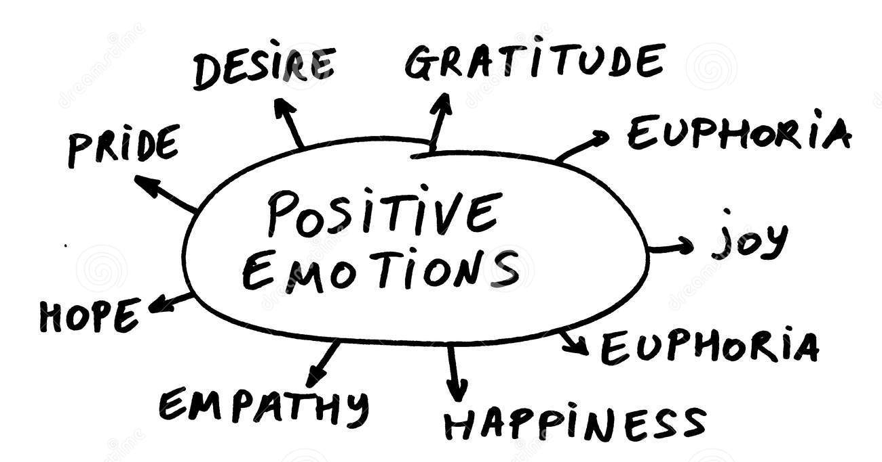
Outcomes of healthy, positive emotions
Improved performance and achievement
More creativity and innovative problem-solving
Better decision-making
More flexible thought processes
Improved memory
Improved hormonal balance

Slide 23
Subjective Well-Being
People with positive emotions are:
  Healthier
  Experience lower rates of chronic illness
  Have fewer symptoms and less pain when they do fall ill
  Live longer
Cohen, S. & Doherty, R., Psychological Bulletin, 2005.

Slide 24
Subjective Well-Being, continued
“People with positive emotions earn more over the course of their lifetimes.”
Diener, E. Social Indicators Research, 2002.

Slide 25
Subjective Well-Being, continued
“People with positive emotions have more satisfying marriages.”
    Harker, L. & Keltner, D.,
    Journal of Personality and Social Psychology, 2001.

Slide 26
On a More Personal Note. . .
People high on positivity have lower disease risks
They are less likely to have high blood pressure, heart attacks, diabetes, or a stroke
Scientists have confirmed that positivity predicts longevity
      "People who express positivity live longer.
      Up to ten years longer.”
      Dr. B. Fredrickson (2009)

Slide 27
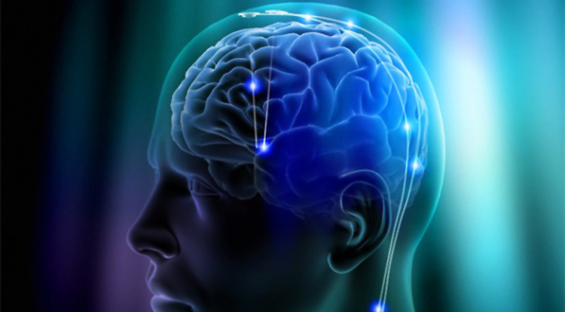
Why?
What happens in the body that creates this connection between emotions and health?
Changes in body chemistry

Slide 28
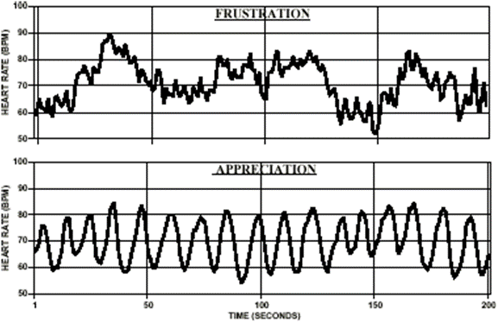
Heart Rate Variability in Positive & Negative Emotional States
Frustration
Appreciation
Institute of Heart Math (2006)

Slide 29
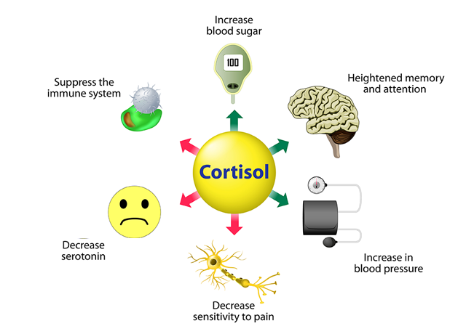
Cortisol: The Stress Hormone
Triggers “fight or flight” – blood (and oxygen) flows to extremities, and away from the brain
Long term
  Elevates blood sugar levels
  Increases bone loss
  Compromises immune function
  Decreases skin repair and regeneration
  Increases fat accumulation
  Destroys brain cells

Slide 30

So what’s going on in our brains
when it comes to
logic and emotion?

Slide 31
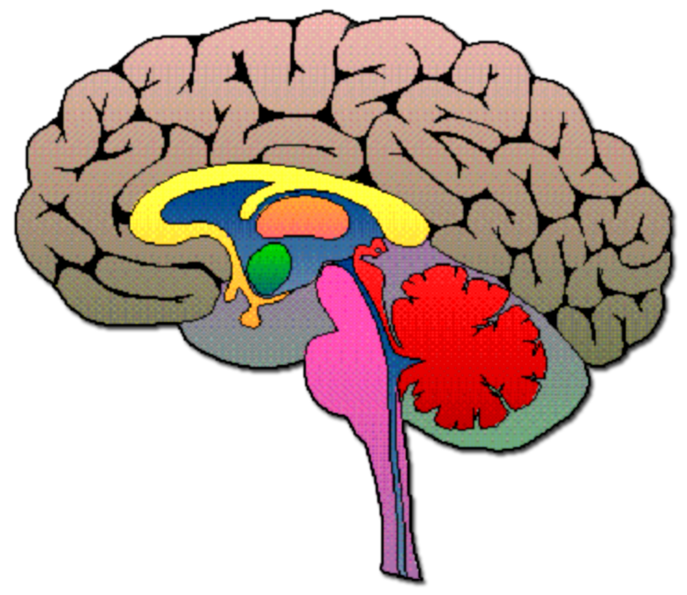
Our THREE Brains
Prefrontal Cortex/Cortex
Brain stem – autonomic
Limbic system/Amygdala – reptile brain (emotion)
Pre-frontal cortex (integrates logic and emotion into judgment)
Limbic System/Amygdala
Brain Stem

Slide 32
Self-Mastery
Prefrontal Cortex
Social & emotional intelligence involves the interaction of two parts of the brain
Limbic System/ Amygdala

Slide 33
So What Does All This Mean?
Self Recognition
Understand own moods and emotions
Social Recognition
Develop a rapport with new people
Social Management
Understand others’ emotions; treat them as they wish to be treated
Self Management
Control over emotions; think before acting

Slide 34
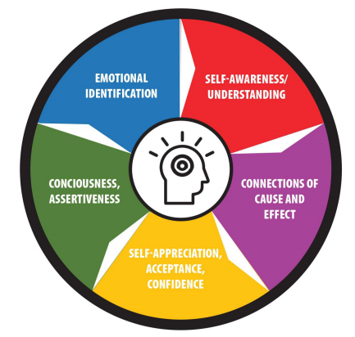
Self Recognition
Emotional Self Awareness
Accurate Self Assessment
Personal Power

Slide 35
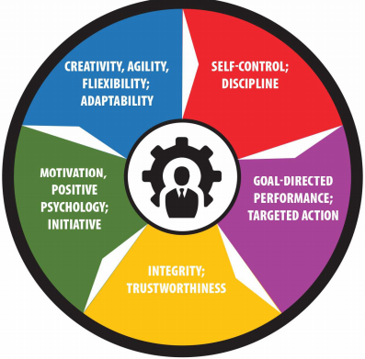
Self Management
Behavioral Self Control
Integrity
Innovation & Creativity
Initiative & Bias for Action
Achievement Drive
Realistic Optimism
Resilience
Personal Agility
Intentionality

Slide 36
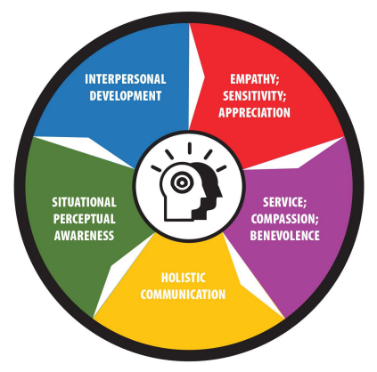
Social Recognition
Empathy
Situational/ Organizational Awareness
Service Ethic

Slide 37
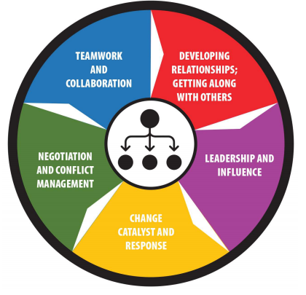
Social Management
Communication
Interpersonal Effectiveness
Powerful Influencing Skills
Conflict Management
Inspirational Leadership
Catalyzing Change
Building Bonds
Teamwork & Collaboration
Coaching & Mentoring Others
Building Trust

Slide 38
S+EI Summary
These competencies are measurable and learnable
Best learned through coaching (and training)
Starts with awareness (an assessment)
Ideal when integrated into the organizational culture
S+EI is a core skill-set
Grounded in science
Proven ROI

Slide 39
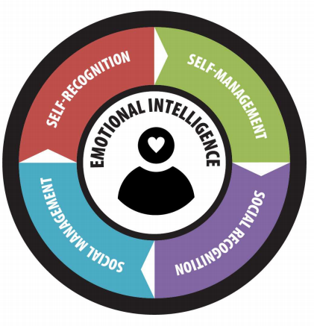
Emotional Intelligence EIQ-2
An Evaluation of Emotional Intelligence Styles

Slide 40
Questions
Do I need to be competent in ALL these areas to have high EQ?
Are some of the competencies more important than others given my life space?
How can I learn which of the competencies I am strong in, and which I need to think of developing?

Slide 41
S+EI = A Collection of Skills
Being aware of what’s going on within us, in the moment
Being aware of what might be going on within others, and responding with care and consideration
Managing ourselves, in the moment
Managing our relationships with others

Slide 42
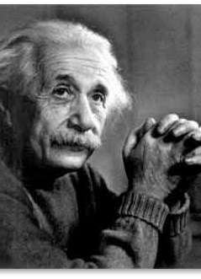
Albert Einstein
“We should take care not to make the intellect our god. It has, of course, powerful muscles, but no personality. It cannot lead, it can only serve.”

Slide 43
Appendix

Slide 44
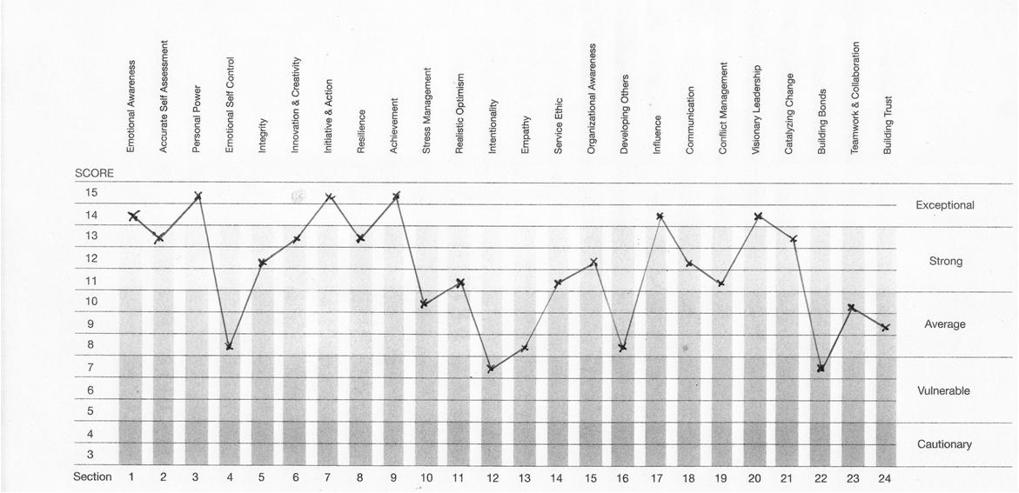
Coaching Exercise # 1: Jerry
831

Slide 45
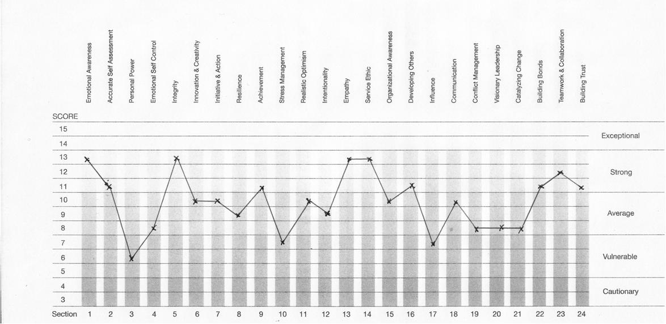
Coaching Exercise#2: Sue

Slide 46
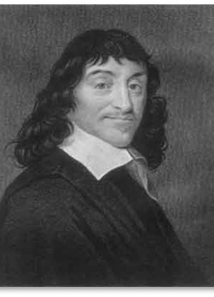
Our Culture Worships Intellect
Descartes - “I think; therefore I am.”
Today’s schools:
  Honor roll
  GPA
  Valedictorian
  SAT, ACT, GRE, LSAT
Today’s employers:
  Class ranking and GPA
  Science and math

Slide 47
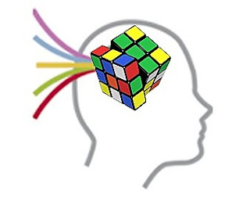

S+EI = Logic + Emotion
Pure logic has no heart
Pure emotion has no reasoning

Slide 48
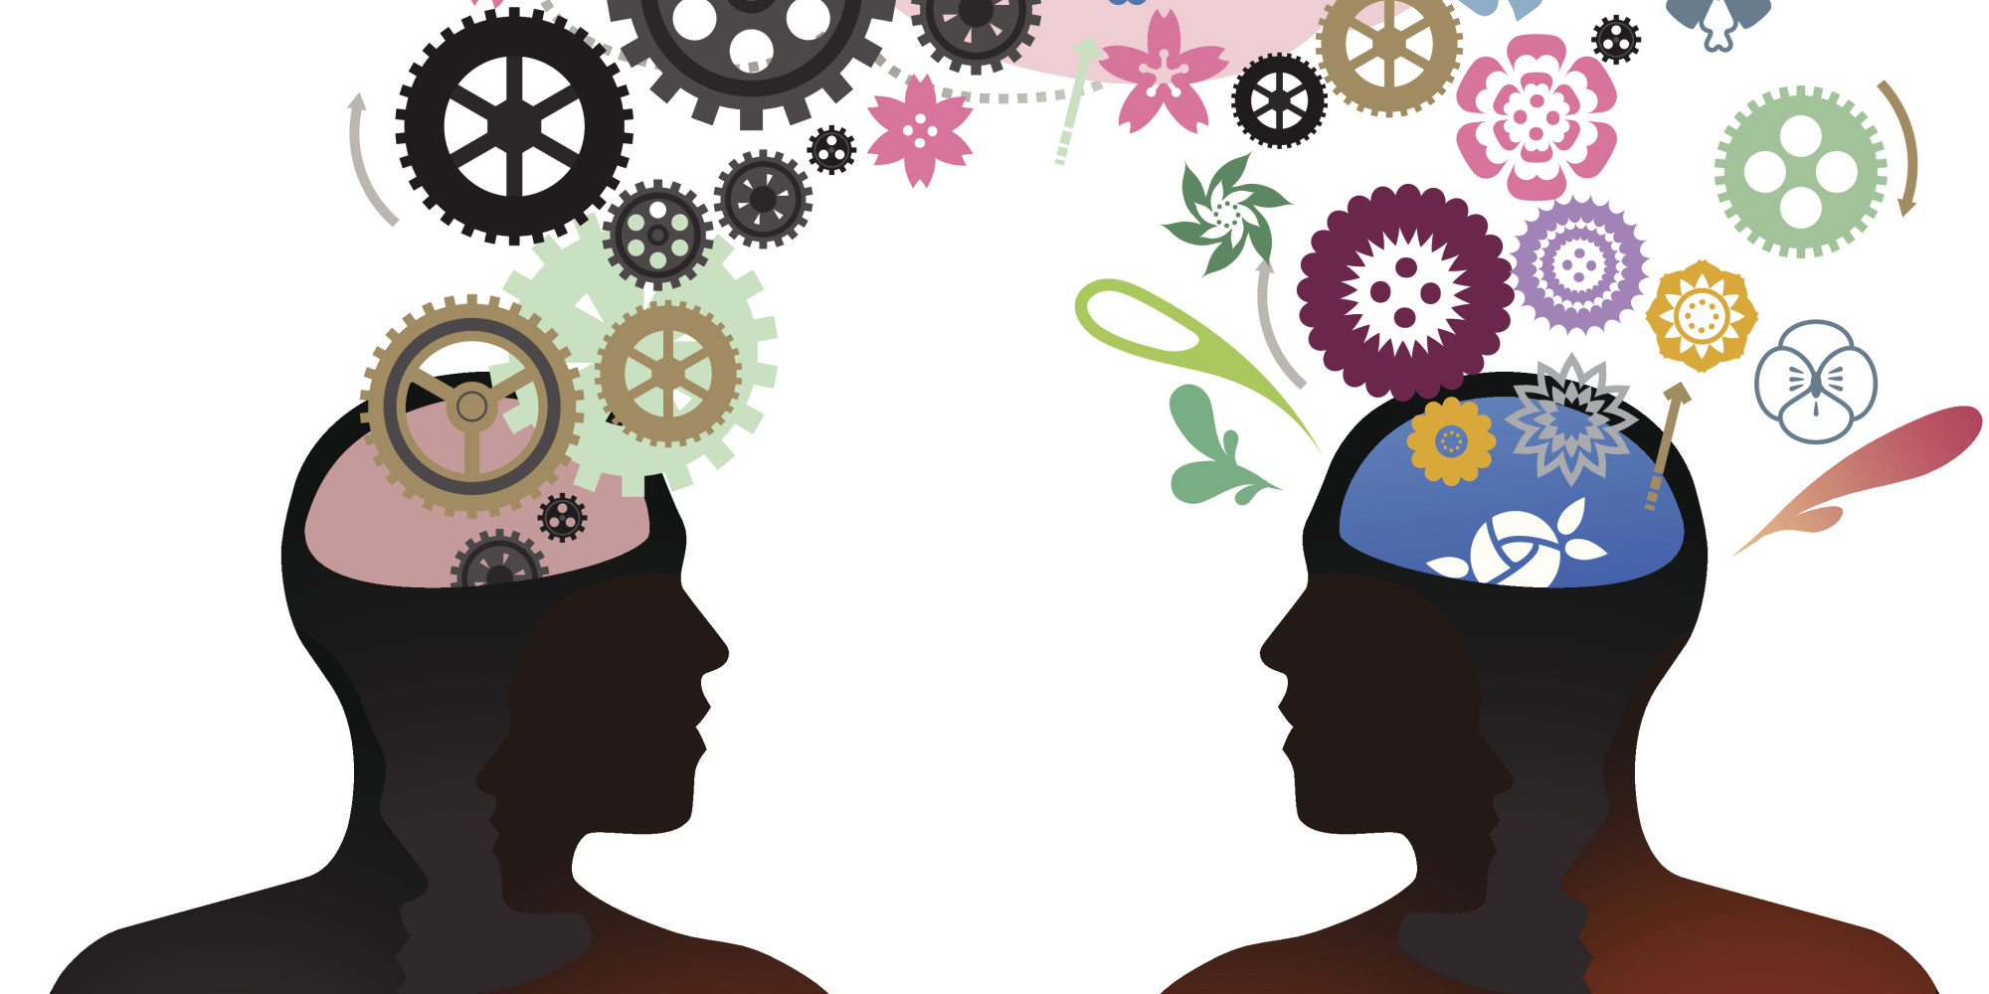
Emotion + Logic = S+EI
Need both emotion AND logic
S+EI can be learned
It starts with awareness (assessment)
It is best learned through coaching
S+EI can be enhanced at any age

Slide 49
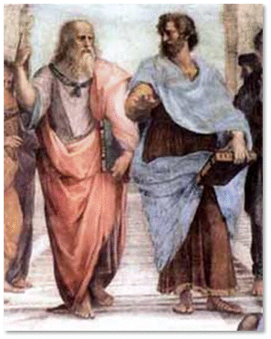
S+EI Is Not a New Concept
“Anyone can become angry; that is easy. But to be angry with the right person, to the right degree, at the right time, for the right purpose, and in the right way—that is not easy.”
Aristotle

Slide 50
Four Steps to S+EI
Notice/Identify/Name the emotion
Understand the source of the emotion
Ask: How is this serving me and my relationship with others?
Manage my response

Slide 51
Group Exercise
Think of a coaching client with high SEI:
Behaviors/words:
How would you coach the client using SEI?
Think of a coaching client with low SEI:
Behaviors/words:
How would you coach the client using SEI?

Slide 52

Gender Differences in S+EI
Men and women have different strengths in SEI
Men give themselves higher scores overall on emotional intelligence than women
Women tend to have stronger skills in:
  Emotional self-awareness
  Interpersonal skills (empathy, developing others, building bonds, teamwork, and collaboration
Men tend to have stronger skills in:
  Self-confidence and personal power
  Achievement drive
  Emotional self-control
Remember, SEI can be learned and developed
Petrides & Furnham (2000)

Slide 53
The Smarts that Count
EQ ≠ IQ
Similar IQs ≠ similar performance
The competitive edge is emotional intelligence
Success = 80% EQ, 20% IQ (Goleman, 1998)
S+EI can be learned – it takes:
  Awareness, Time, Patience, Commitment
Benefits for the individual, team and organization are not only worthwhile but invigorating.

Slide 54

The Medical Case for SEI
The “Big Three” Negative Emotions
Anger/hostility
Anxiety/fear
Sadness/depression

Slide 55
Anger
Long-term studies lasting 3-7 years
People who report high levels of anger on a frequent basis had double the chance of a cardiac event if they were initially healthy
For individuals with existing heart disease, anger led to a seven-fold increase in their risk for another cardiac event
Koskenvuo, Psychosomatic Medicine, 1988.

Slide 56
Emotions & Heart Disease
A Harvard Medical School study of 1,623 heart attack survivors found that when subjects got angry during emotional conflicts, their risk of subsequent heart attacks was more than double that of those who remained calm.
Mittleman M.A., Triggering of acute myocardial infarction onset by episodes of anger. Circulation, 1995.

Slide 57
Hostility
Duke University medical students
Hostility scores in med school and 25 years later
More of a personality/attitudinal style of viewing the world and other people
Those with higher hostility scores had almost 5 times more heart disease and more than 5 times the death rate than those with low-moderate scores
      Kawachi, American Journal of Public Health, 1997.

Slide 58
Anxiety
More than10 studies on anxiety and heart disease
Over 40,000 participants
Symptoms: worry, irritability, difficulty concentrating, muscle tension
Risk of heart disease is 2-7 times higher in people with high levels of anxiety compared with people having lower anxiety
Kubzansky & Kawachi, Annals of Behavioral Medicine, 2000.

Slide 59
Depression
20 long-term studies
Over 25,000 participants
Individuals followed for up to 40 years
Depression leads to a 2-4 times increase in the risk for heart disease
Rozanski, Blumenthal & Kaplan, Circulation, 1999.

Slide 60
Stress
Up to 80 percent of all doctor visits are for stress-related or stress-induced illnesses. Harvard Medical School
People who live with very high levels of stress are 4.5 times more likely to die from a heart attack or stroke. National Institute of Health

Slide 61
Health Implications of Stressful Life Events
Stressful life events are highly correlated with
  Vulnerability to illness
  More rapid disease progression
  Increased mortality

Slide 62
Stressful Life Event Study
1 million married people, aged 35 to 84 who had lost spouses
Followed for 5 years
Widows had a 6% higher death rate than non-widowed women of the same age
Bereaved men had a 17% higher death rate than their non-widowed counterparts
Martikainen & Valkonen, Journal of Epidemiology & Community Health, 1996.

Slide 63
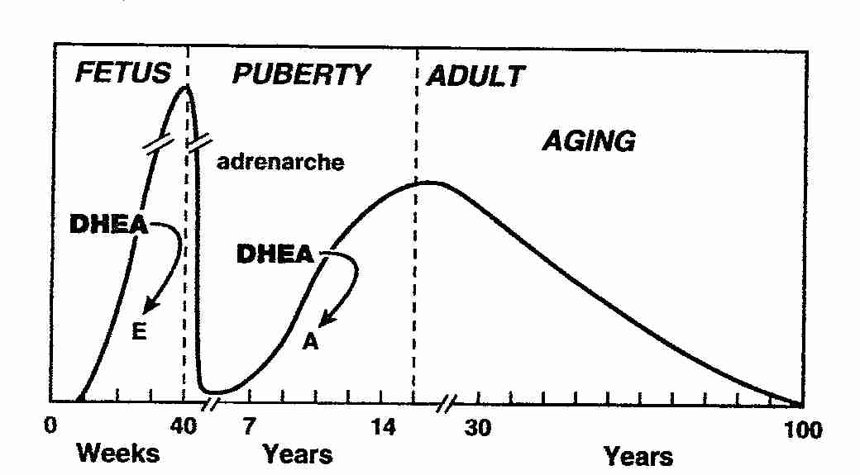
DHEA: The “Anti-Aging Hormone”
Stimulates the immune system
Lowers cholesterol
Promotes bone deposition and growth
Builds muscle mass
Enhances memory
Counters the effects of aging
Stimulates clarity of thinking and other mental functions
Also known as “the vitality hormone”

Slide 64
The Answer? Emotional Intelligence
Awareness and Managing our Emotions leads to:
  Less stress (Cortisol; DHEA)
  Improved immunity
  Decreased risk of serious disease (cardiovascular, hypertension, cancer & autoimmune disorders)
  Slower disease progression
  Longer life span

Slide 65
Research: Emotional
Self-Management and Stress
Subjects who used stress management techniques for one month significantly reduced their cortisol levels (23%) and increased their DHEA (100%)
On psychological tests, their stress scores for anxiety, burnout and guilt were decreased, and their emotional health scores for caring and vigor were increased
Journal of Integrative Physiological & Behavioral Science (1998)

Slide 66
Emotional Management Leads to Health and Longer Life
Groundbreaking study
1,200 people at high risk of poor health
Those who learned to alter unhealthy mental and emotional attitudes through self-regulation training were more than four times more likely to be alive 13 years later than an equal-sized control group
Journal of Behavioral Research (1991)

Slide 67
Questions & Answers

