Slide 1

Leaders That Coach:
Coach Training for Leaders, Managers, and Supervisors
3P Consulting System

Slide 2
Welcome
Active participation of everyone is essential
Confidentiality is expected
Listen actively; seek to understand
We will start and end on time
One discussion at a time—no side conversations
Be mindful of your “floor time”
Breaks and lunch logistics
Other ground rule suggestions?

Slide 3
Agenda
Day 1
  What is coaching and a “coach approach to leadership”?
  Why bother?
  Coaching style vs. traditional management style
  A model of coaching
  Foundational coaching skills
  The coaching conversation
  PRACTICE

Slide 4
Agenda, continued
Day 2
  Your communication and coaching style
  Skills for developing others
  Observation & feedback
  Action planning
  PRACTICE

Slide 5
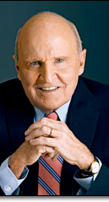
Jack Welch
CEO of General Electric
1981 - 2001
“Being a leader changes everything. Before you are a leader, success is all about you. It’s about your performance, your contributions. It’s about getting called upon and having the right answers. When you become a leader, success is all about growing others. Your success as a leader comes not from what you do but from the reflected glory of the people you lead.”

Slide 6
Learning Objectives
Transition your leadership style from supervisor to Coach
Learn how to facilitate coaching conversations based on the coaching model regardless of setting or situation
Provide guidance and encourage top performers to achieve even more
Learn and appreciate your natural communication style and the styles of others
Foster a coaching culture in your department or division
Plan and execute your own action plan to sharpen your coaching skills

Slide 7

Definition of Coaching
Coaching is a developmental process designed to help individuals and teams achieve and sustain top performance in support of the organization’s goals.

Slide 8
What is Coaching?
An essential skill for leaders and managers
An ongoing partnership, a sustained alliance
A process for promoting discovery, learning, growth and higher levels of performance
A collaborative effort where:
  The coach serves as a strategic thinking partner
  Manager and employee think and plan together

Slide 9


The Telling – Asking Continuum
Pros & Cons?

Slide 10

What Coaching is Not
Telling people what to do
A function of Human Resources
Resolving performance problems
A one-time event
Counseling, consulting, or training
A management fad of the month
Time-consuming

Slide 11
Leadership Styles are Changing
Traditional management is no longer working
According to Gallup research:
  19% of employees feel engaged in large companies (>5000 employees)
  22% feel engaged in mid-sized companies
  33% feel engaged in small companies (< 50 people)
This amounts to less than 1 out of 3 engaged employees in the best circumstances.
Buckingham & Coffman. First Break All the Rules. 1999.

Slide 12

People join organizations . . .
. . . but leave managers
  The #1 reason people leave their jobs is because of their direct manager.

Slide 13
Talented Managers
The opposite of disengaged employees is satisfied, engaged employees
“Talented managers” – those who take a coach approach to managing and leading – tend to have more satisfied employees
Organizations with above-average employee satisfaction scores also demonstrate:
  38% higher customer satisfaction scores
  22% higher productivity
  27% higher profits

Slide 14

What do People Want in a Manager?
To know what is expected of them at work
The opportunity to do their best every day
To make a contribution
To be recognized for their work
To have someone at work care enough to encourage their development
To have their opinions count and be heard
To have the opportunity to learn and grow
To be respected

Slide 15
Dr. Gerald Graham
Wichita State University
Surveyed 1,500 people from a wide variety of organizations and professions
58% of respondents seldom if ever received personal thanks from their manager
76% seldom if ever received written thanks from their manager
A verbal or written thank you from one’s manager are the top two incentives according to employees

Slide 16

Benefits of Coaching
Makes the manager’s job easier
Reduces turnover and associated costs
Increases productivity; improves work quality
Promotes innovation (safe place to take risks)
Clarifies manager’s expectations
Stretches people to reach for bigger goals

Slide 17

Six Leadership Approaches
Authoritative (Visionary)
Democratic
Affiliative
Coaching
Coercive
Pace-setting
Daniel Goleman. “Leadership That Gets Results.” Harvard Business Review, March-April, 2000.

Slide 18
Traditional Manager vs. Leaders That Coach
Traditional Manager
Leaders That Coach
  Directs, dictates, talks a lot
  Presumes, assumes
  Manages only for results
  Solves problems in isolation
  Assigns blame
  Guides, empowers, listens a lot
  Explores, discovers
  Manages the development of employees
  Creates partnerships with employees to collaboratively solve problems
  Takes responsibility

Slide 19

Coaching Skills
Foundational Skills: The Practice of Dialogue
Advanced Coaching Skills: Developing Others
The Critical Skill: Honest Feedback

Slide 20
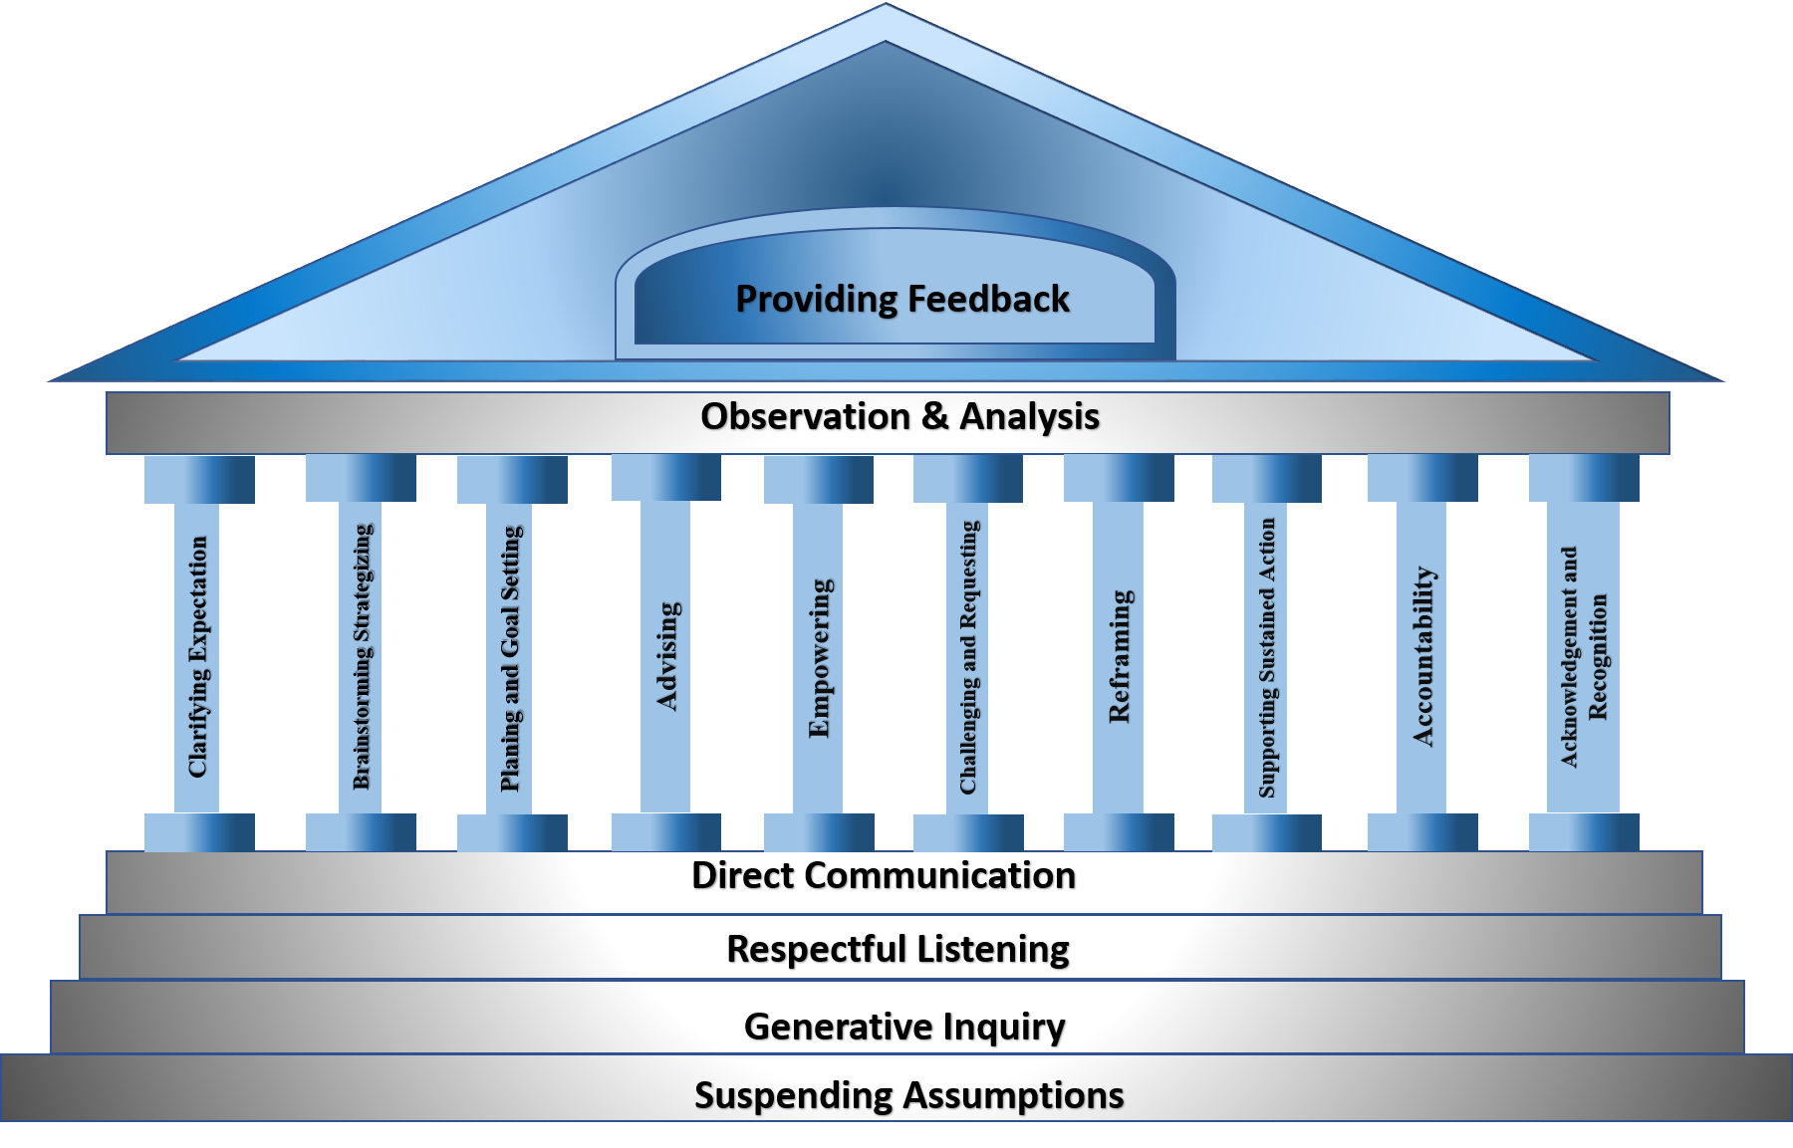
A Model of Coaching
Model of Coaching © 2012 Dr. Laura Belsten and ISEI®

Slide 21

The Practice of Dialogue
Shared inquiry, a way of thinking together
Four primary skills:
  Suspending assumptions
  Generative inquiry ➢ Smart Questions
  Respectful listening ➢ Deep Listening
  Direct communication ➢ Straight Talk
At its core, an attitude of respect

Slide 22

Suspending Assumptions
The Ladder of Inference
I observe
I select data
I make assumptions
I add meaning
I draw conclusions
I adopt beliefs
I take actions based on my beliefs

Slide 23
Suspending Assumptions: How to do it
Be aware of your existing assumptions and new ones in the moment they arise
Give voice to your assumptions; ask for clarification and input
Be open to new ideas
Be willing to be influenced by the conversation
Make it safe for people to say what they think
Suspend your certainty
Hold your judgments and criticisms – be aware of thoughts and feelings as they come up; hold them for later use
Avoid stating your opinions & positions from the outset; ask questions to generate mutual exploration

Slide 24

Smart Questions
Powerful
  Focus is on generating new thinking and expanding possibilities
Questions should be
  Open-ended
  Brief (no speeches leading up to the question)
  Neutral
  Constructive
  Intended to evoke forward movement

Slide 25
Smart Questions: How to do it
Break the habit of only making statements
  Strive to make at least 50% of your utterances questions
Carefully formulate questions that invite exploration and generate discovery
Frame them in a way that evokes an image of a positive or better future
Develop a list of good questions
Practice, practice, practice

Slide 26


Neutral Questions
Are free of bias
“What should we do about quality control?”
“Given the number of errors detected on the widget manufacturing line, don’t you think we should create a quality control department?”
“Given the current budget situation, do you really think we should spend money to establish a quality control department?”

Slide 27
Neutral Questions Exercise
How would you modify the sample questions in your Guidebook to make them neutral?

Slide 28

Constructive Questions
“What could we do to eliminate racial bias from our hiring processes?
“How would our organization be different if it reflected to the diversity of the community we serve?”

Slide 29
Examples:
What are the benefits of a win-win solution?
What would be the best possible outcome?
Which ideas have you already ruled out?
What has not yet been considered?
If resources were not an issue, what would we do?

Slide 30

Suspending Assumptions & Generative Inquiry Exercise
Work in groups of three

Slide 31
Suspending Assumptions & Generative Inquiry
One person volunteer to share a challenging work situation you have encountered in the past week; explain the situation for two full minutes
Everyone else listen only—do not interrupt for questions
Listeners develop 3-4 thought-provoking questions designed to invite exploration and generate discovery
Review questions with each other
Switch roles and repeat the exercise

Slide 32

Dialogue Skills
Suspending assumptions
Generative inquiry – Smart Questions
Respectful listening
Direct communication

Slide 33
Respectful Listening
Listening is an intentional and active exploration for meaning
Listening for context by hearing the words and knowing enough about a person’s external and internal circumstances to discern what is really being said at a deeper level
Listening reflectively by using appropriate attending, following, and reflecting skills
Listening for:
  Verbal messages
  Nonverbal messages
  Context
  Sharp notes - gaps, distortion, dissonance

Slide 34
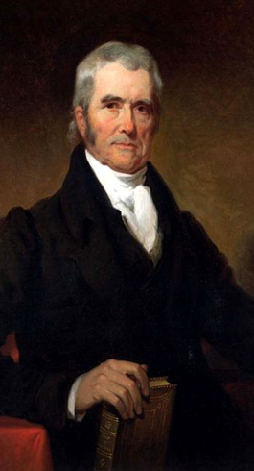
The Honorable John Marshall
Chief Justice of the Supreme Court 1803 – 1835
  “Listening well is as powerful a means of communication and influence as to speak well.”

Slide 35

Listening for Context
Listen for what’s not being said
Listen for the person’s
  Needs
  Motivations
  Values
  Goals and aspirations
  Energy level
  Strengths and where development is needed
  Barriers in his way and needed support

Slide 36
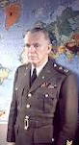
General George C. Marshall
War Hero
Secretary of State
Developer of the Marshall Plan
Nobel Peace Prize Laureate
“Listen to the other person’s story. Listen to the other person’s full story. Listen to the other person’s full story first.”

Slide 37

Reflective Listening Skills
Attending
Using a posture of involvement
Establishing and maintaining eye contact
Reinforcing what is being said through appropriate facial features and body movement
Assure a non-distracting environment which demonstrates that you are psychologically present to the speaker

Slide 38
Active, Receptive, and Reflective Listening
Following
  Tuning in to how the other person is thinking and viewing a situation
  Door-openers
  Encouragers
  Open-ended questions
  Attentive silence

Slide 39
Active and Reflective Listening
Actively Reflecting
Comprehending, validating, accepting, acknowledging (not judging)
Expressing understanding; empathizing (not necessarily agreeing); viewing things from the other’s perspective

Slide 40
Active and Reflective Listening
Actively Reflecting
Acknowledging the mood of the other person, their emotional state
Absorbing and re-stating the speaker’s content and/or feeling Interpreting & summarizing (more than simply paraphrasing)
Reflecting meaning / feeling
Clarifying what the other person has said

Slide 41
How to do it
Set aside your own agenda; let go of the inner clamoring
Actively intend to listen and understand another’s ideas, position, feelings or attitude
Listen for what is said and not said
Listen for context
Engage in reflective listening
Acknowledge feelings
Say what you heard to verify
Ask for clarification; verify what was said and meant
Allow silence
“You cannot truly listen to someone and do anything else at the same time.”
M. Scott Peck

Slide 42

Phrasing Examples
Help me understand what you mean by . . .
Tell me if I’m hearing you right . . .
Hmmm. It sounds like you’re feeling . . .
It sounds like you’re really passionate about this.
When you said . . . I assumed you meant . . . Is that right?

Slide 43

Respectful Listening
Work with a partner

Slide 44
Respectful Listening
Think of a situation you have encountered recently
Use respectful listening and smart questions to coach each other
Take turns being coach. As coach:
    Spend 5 minutes listening and asking questions
    As you listen, write down clues as to what you’re hearing
    Use your reflective listening skills (attending, following, reflecting)
    Ask questions to clarify
    Verify what you hear

Slide 45

Direct Communication / Straight Talk
Telling the truth; being candid
Reveals your inner thoughts & perceptions
Identifying mismatches between what is said and what is known
Challenges distortions; identifies gaps
No put-downs or “make-wrongs”

Slide 46

“Courageous speech
has always held us in awe.”
David Whyte
The Heart Aroused

Slide 47
Straight Talk Scenario
Read the situation report and discuss in your assigned groups

Slide 48
What Would You Do?
One of your coworkers, a Vice President, comes to you with a problem. She recently received a promotion, and is relatively new to this level of leadership.
She tells you about an individual on her team who is not performing. This individual was a member of the team before her promotion, and she was acutely aware of the problem before becoming VP. Everyone else on the team is aware of the problem as well, and it is significantly hurting morale.
Case Study © 2012 Dr. Laura Belsten and ISEI®

Slide 49
What Would You Do?
Her team is expecting her to take action to resolve the issue with the problem employee. After all, she was the one to receive the promotion. She is their last hope.
A lack of action on her part will further the downward spiral in morale, possibly result in the loss of valuable talent, and seriously damage her credibility as a leader.
How will you coach her? In addition to deep, respectful listening and smart questions, demonstrate your skills of “Straight Talk.”
Case Study © 2012 Dr. Laura Belsten and ISEI®

Slide 50
Direct Communication Model
The following communication structure will help you to conduct meaningful conversations that make a big difference.
Hundreds of leaders have used this structure with great success. You can too.
The format consists of four main elements:
  Opening Statement
  Observation
  Impact
  Request

Slide 51
Direct Communication Model
Opening Statement
  ‘‘I want to talk to you about (the category of performance).’’
Observation
  ‘‘I’ve observed (describe the performance or behavior).’’
Impact
‘‘The impact is (describe the impact on the people or the job being done).’’
Request
‘‘From now on, I’d like you to (describe how to improve performance/behavior).’’

Slide 52
Straight Talk: How to do it
Solid foundation of trust is a prerequisite
Listen for mismatches, gaps, distortions, biases, or lack of ownership of the problem
Tune into your own reactions and thoughts about what you’ve heard expressed and ask,
  “What needs to be expressed now?”
Frame your truth diplomatically

Slide 53
Straight Talk: How to do it
Speak quietly, non-judgmentally and non-emotionally
Use specific examples
Make your thinking process visible
Trust yourself to say the right thing if it comes from
the intention of wanting to help the other person grow.

Slide 54
Phrasing Examples
Opening statements
Your opening statement will identify the general topic of the coaching.
For example:
  ‘‘I want to talk to you about…”
    …the project you completed this morning.
    …the goals and objectives status report for your department.
    …the plan you submitted for our reorganization.

Slide 55
Phrasing Examples
Observation statements
‘‘I’ve observed…
  …your status report did not include your targets for last Friday.’’
  …that you volunteered to help out on Jim’s project this morning.”

Slide 56

Phrasing Examples
Impact statements
‘‘The impact is…”
Describe a specific behavior or aspect of performance. This makes it clear why you are bringing this matter to their attention.
What they did or how they behaved had a positive or negative impact on other people in the organization or on performance in some way.
It may have impacted customer service, costs, morale, the company’s image, quality, efficiency, or something else.

Slide 57
Phrasing Examples
Request statements
‘‘From now on, I’d like you to…”
What you have accomplished up to this point is a description of a behavior or performance and its impact on the job being done.
Corrective coaching must also include suggestions on how to improve the performance or behavior.
Be clear in your description of the desired level of performance and why.

Slide 58
Other Phrasing Examples
May I offer my thoughts and trust you will receive them as intended—as a way to help you overcome this hurdle?
Sue, I hear you say the morale of your team is your highest priority, but do you realize that by refusing to deal with a non-performer, you are hurting morale?
John, what part of this problem is yours?
I’m having difficulty seeing it the way you’re seeing it . . . Here’s what I’m seeing . . .

Slide 59
Round-Robin Coaching
Work in Groups of Three

Slide 60
Round-Robin Coaching
1 person is the coach, 1 is the person being coached, and 1 person is the observer
Coach for 10 minutes
Debrief for 3 minutes; the observer provides feedback on the coaching skills observed; the person being coached provides feedback as well.
Switch roles and repeat the exercise x 2

Slide 61
The Coaching Conversation
Expand the possibilities / Brainstorm
Narrow the Focus
Step 1 Step 2 Step 3 Step 4 Step 5 Step 6 Step 7 Step 8
Check in Define the Determine Generate Evaluate Select the Develop Anchor the
Challenge the Goal: Options Options & Most Viable the Action Plan
State Desired Do a Option & Plan
Outcomes Values Create a
Check Strategy

Slide 62

1. Check-in
Focus the conversation
Establish the purpose of having a conversation
What is the issue (or issues) to be addressed?

Slide 63

2. Define the Challenge
Establish a common understanding of the problem or challenge
Identify the stakeholders being impacted
Assess the budgetary implications of the challenge (if necessary)
State the problem in a single clear statement

Slide 64

3. Determine the Goal
What is the ideal or desired outcome?
If this issue is resolved, what will success look like?
What is the result if this problem is resolved?
Craft a goal statement (this is not a solution statement, but a goal statement)

Slide 65

4. Generate Options
Ask questions to stimulate thinking
Encourage innovative thinking
Quiet your mind & listen non-judgmentally
Refrain from offering your own solutions (at least initially)
Brainstorm to explore options
Paraphrase what you are hearing
Draw out consequences
Share personal experiences and your ideas after the person you are coaching has offered his/hers

Slide 66

5. Evaluate Options
Begin to narrow the focus
Eliminate unworkable options
Do a values check – are the options you are considering aligned with the organization’s mission, vision and values? Are they fair? The right thing to do? Eliminate any options that don’t pass the values check.
Of the remaining options, identify the one or two that will get you most directly to your goal, to problem resolution

Slide 67

6. Select the Most Viable Option
Brainstorm various strategies to get you to your goal
Explore resource needs of the various strategies
Identify potential barriers of each strategy and what action is needed to clear barriers
Select the most viable option and begin to guide the person you are coaching to the development of an action plan

Slide 68

7. Develop the Action Plan
Guide the person you are coaching to identify, step-by-step, what actions they will be take and the estimated time to complete those actions
Help the individual break the steps down into “bite-sized chunks”
Ask about other individuals who need to be informed or involved
Ensure the timing is realistic and establish check-in milestones
Discuss a fallback or alternative plan in case the plan doesn’t work

Slide 69

8. Anchor the Plan
Ask the person you are coaching to recap what they are going to do
Ask for their commitment to completing it, and to checking in with you at various milestones
Emphasize your support and availability should problems arise
Establish accountability to the plan and the timing for completion

Slide 70

Initial questions for each step
1. Check in
What would you like to focus on today?
How would you like to use our time together today?
2. Define the challenge
What’s the problem? How would you define it?
Who’s being impacted? What’s it costing us?
3. Determine the goal
What’s your goal?
What’s the ideal outcome?
What would success look like?
What result are you seeking?

Slide 71
4. Generate options
What has worked for you in the past? (or for others?)
What are our options here?
That’s one . . . what’s another?
What might happen if you go that direction?
5. Evaluate options
Which of these options is most workable?
Which one is the most sound in terms of our mission & values?
Are these options fair to all concerned?
What’s the right thing to do?

Slide 72

6. Select the most viable option
Of the approaches we’ve discussed, which would work best?
What resources will you need?
What might get in the way?
Are there any unforeseen consequences we could encounter with this options?
What would the outcome of this approach be?
Will it get us to our goal?
7. Develop the action plan
What needs to happen first?
What are your next steps?
Who else needs to be involved (or be informed)?
What is your sense of timing on this? How long will it take to complete each step?
What milestones do you anticipate?

Slide 73
8. Anchor the plan
Would you just recap what you’re going to do?
What will you do, by when? Who will you involve/inform?
For our next meeting, what date will work?
As you have recapped this, what other items come to mind that need to be addressed?
What can I do to support you?
I look forward to your next check-in
Please know that if anything comes up, anything at all, my door is open. Please let me know how I can help.

Slide 74
The Coaching Conversation
Work in Groups of Three

Slide 75
The Coaching Conversation
1 person will be the coach, 1 person will be coached, and 1 will be the observer
The person being coached should think of a real situation they have encountered in the past week or two
Use all the skills we’ve learned so far today—suspending assumptions, deep listening, smart questions, and straight talk
Use all those skills in a complete coaching conversation
Coach for 15 minutes, give feedback for 5, then switch roles x 2

Slide 76

Before Next Time . . .
Refine your personal coaching questions for each step of the coaching conversation
Engage in at least 3 coaching conversations over the next three weeks
Audacious Goal: engage in 7 coaching conversations between now and the next time we get together

Slide 77

What did you learn?
Course reflections

Slide 78

Leaders that Coach:
Coach Training for Leaders, Managers, and Supervisors
Part II

Slide 79
Day 2 Agenda
  Communication & coaching styles
  Skills for developing others
  Observation & feedback
  Action planning
  Coaching practice

Slide 80
How did you do ? Coaching Conversation
Expand the possibilities / Brainstorm
Narrow the Focus
Step 1 Step 2 Step 3 Step 4 Step 5 Step 6 Step 7 Step 8
Check in Define the Determine Generate Evaluate Select the Develop Anchor the
Challenge the Goal: Options Options & Most Viable the Action Plan
State Desired Do a Option & Plan
Outcomes Values Create a
Check Strategy

Slide 81
A Model of Coaching
Model of Coaching © 2012 Dr. Laura Belsten and ISEI®

Slide 82

The DISC Behavioral Style Indicator
Understanding your communication and coaching style
A snapshot of how people give and receive feedback, communicate and coach
Not a personality profile or psychological tool; it measures behavior
Helps you identify your preferred style and the style preferred by others
Helps you build on your own strengths and the strengths of others
Helps you form better working relationships

Slide 83
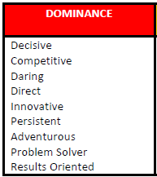
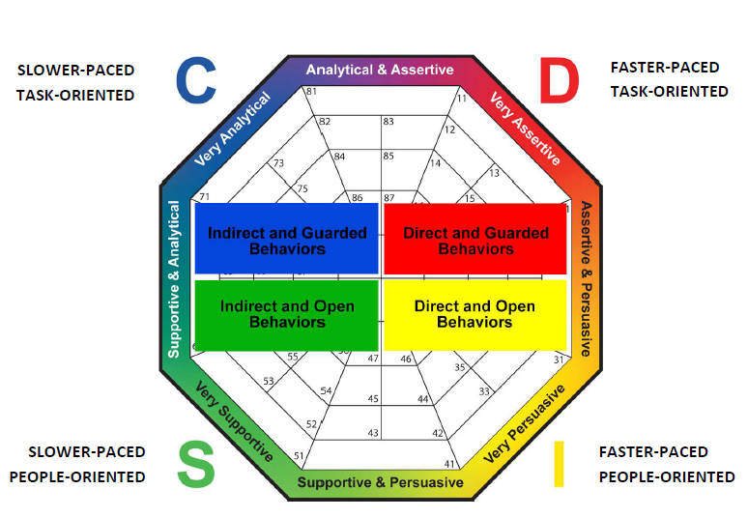
D / Dominance

Slide 84
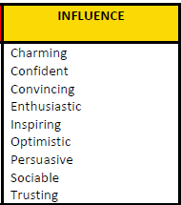
I / Influence

Slide 85
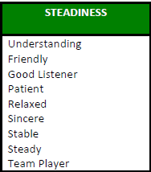
S / Steadiness

Slide 86
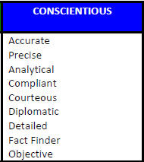
C / Conscientious

Slide 87
DISC Exercise
Work with group members who share your style preference: D I S or C

Slide 88
DISC Exercise
In groups by style preference, D I S or C, answer these questions for report out in 15 minutes:
  What are the key characteristics of your style?
  What is most important for others to know about working with your style?
  How does your style like to be coached?
  What questions would work well for your style?
  How does your style buy a gift?

Slide 89
Developing Others
“The greatest good you can do another is not just share your riches, but reveal
to him his own.”
Benjamin Franklin

Slide 90

Developing Others
The heart of coaching
Set of skills designed to help others think rigorously, creatively and strategically.
It’s about “deepening the learning” and “forwarding the action.”
Generative inquiry, respectful listening and direct communication remain the foundation, but there’s more. . .

Slide 91
The Ten Pillars
Clarifying expectations
Brainstorming/strategizing
Planning and goal setting
Advising
Empowering
Challenging and requesting
Reframing
Supporting sustained action
Fostering accountability
Acknowledging/recognizing

Slide 92
Coaching Skills Exercises
Work in groups as assigned

Slide 93
Coaching Skills Exercise #1
Each person selects a “pillar” of coaching such as a developing others skill or proficiency
Take15 minutes to review the skill and develop a role play, skit, scenario, or other means to illustrate one skill to the rest of the group
Each team takes 5 minutes to demonstrate the skill
The rest of the group has to guess which skill the small group is demonstrating

Slide 94
Exercise #2
The Ten Pillars + the Coaching Conversation
Groups of 3 or 4
Decide who will be coach, the person being coached (PBC), and observer(s)
PBC selects a current challenge or problem
Coach for 15 minutes using the Coaching Conversation and the Ten Pillars skills
Observer(s) give 3 minutes of feedback
PBC gives 2 minutes of feedback
Switch roles, repeat

Slide 95
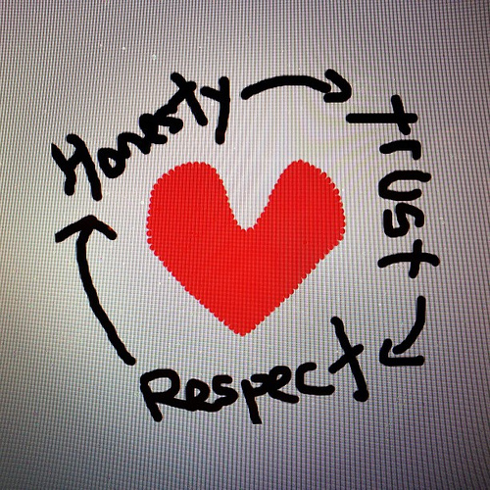
Providing Honest Feedback
Ongoing
Honest
Feedback ≠ Criticism
Fosters growth
Motivates
Builds confidence
Both positive AND constructive needed
Based on observation and analysis

Slide 96
Honest Feedback: How to do it
Be specific
Be timely
Be sincere
Balance positive and constructive
Don’t judge
Don’t guess at motives
Avoid absolutes like always and never
Prepare
Make it ongoing

Slide 97
Coaching Practice
Groups of 3 or 4
Rotate roles. If you haven’t yet coached, now’s the time. Decide who will be coach, PBC, and observer(s)
Review the scenario; prepare for the coaching conversation
Practice coaching for 15 minutes
Observer(s) give 3 minutes of feedback
PBC gives 2 minutes of feedback

Slide 98
Coaching Scenario: Honest Feedback
You are the Vice President of ABC Corp. You observe one of your employees working very effectively upwards with the other VPs, and the company President. They respect him, his expertise, his reports, his recommendations, and his insights, and they have also expressed to you that they appreciate his helpfulness.
However, you have also observed that this individual has difficulty working with his direct reports and others in the department. He is often gruff and impatient with directs and other employees not at his “level” in the organization.
Case Study © 2012 Dr. Laura Belsten and ISEI®

Slide 99
Coaching Scenario: Honest Feedback
With these folks, he seems to prefer to work alone, is not a team player, and withholds information. You are his supervisor and the only person on his immediate work team with whom he seems to be able to maintain a civil working relationship.
His behavior is seriously impacting the performance of your department, and the organization as a whole, and the time has come for you to provide him with some feedback on his behavior. He has just completed making a successful report to the senior team (VPs and President), and then made snide and sarcastic comments about a peer at one of your team meetings. How will you give him feedback?
Case Study © 2012 Dr. Laura Belsten and ISEI®

Slide 100

Designing the Alliance
Build a bond of trust
Tune into other person’s view of the world
Generate awareness
Confidentiality & ethics

Slide 101
Tuning in to the Worldview of Others
Why did you come to work here? What keeps you here?
Where do you want to be in three years?
What do you enjoy? What do you want to do more of?
What are your greatest challenges? How can I support you in overcoming those?
Do you prefer being given a specific set of directions, or do you prefer to create the plan yourself?
How do you prefer to be recognized for your work?

Slide 102
Generating Awareness
Quantitative and qualitative 360s
Other assessments
  DISC
  Emotional Intelligence
  Motivators
Encourage self awareness
Encourage social awareness

Slide 103
Confidentiality & Ethics
What gets discussed during coaching sessions remains within the coaching relationship. Period.
Candor + Tact = Effective Coaching (do no harm)
Give credit for the ideas generated by the person being coached
Other?

Slide 104
Developing Your Coaching Skills
Walk your talk by developing yourself
  Read books and articles on coaching
  Start a journal
  Work with a coach – experience coaching
  Create a culture that allows for risk and therefore, growth and development.

Slide 105
What did you learn?
Course reflections

