Slide 1

Five Behaviors of a Healthy Organization
3P Consulting System

Slide 2

What You’re Going To Learn Today
Recommending and Facilitating

Slide 3
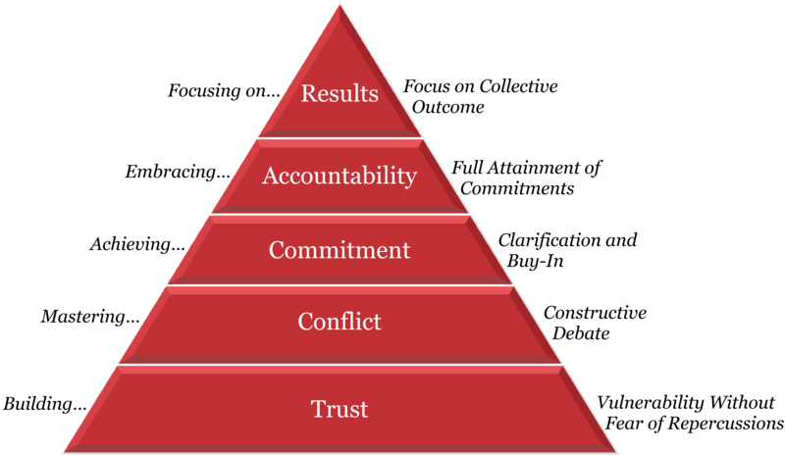
Lencioni 2002

Slide 4

Indications
Vital 33
  Openly invite feedback
  Leave meetings in agreement
  Clear and open discussions
  Easy to talk with leaders
  Challenge existing practices

Slide 5

Indications, Continued
Group facilitation, observations
Coaching
360 Multi-rater surveys
Slow, labored work processes

Slide 6

Preparation and Time Commitment
Allow at least 1 week for survey administration
Program Administration:
Can be delivered via retreat in 2 ½ days OR two 1-day retreats (6 hours)
Can be delivered 2 hours per week over 6 weeks
Can be excerpted into a 1-day program (6 hours)

Slide 7
Traps to Avoid
This program requires participation to succeed; plan some icebreakers to get everyone engaged
This program sometimes gives rise to conflict; it’s important to prepare the group for that possibility by establishing trust at the onset
Set Clear Expectations:
  How the team is going use the information from their reports
  What behaviors have to change
  What new behaviors are necessary to succeed
  How the group is going to adopt these new behaviors

Slide 8
Questions & Answers

